Slide 1


YOUTHWORKS MISSION TRIP 2017
at First Presbyterian Church in the
Jamaica neighborhood of QUEENS, NY

Slide 2
Jesus told his followers that there are a lot of things trying to hurt and destroy us, but from the very beginning, God intended us to live good and full lives. Full of right relationships with God and with others. And that’s why Jesus came: to restore the good life we are intended for—not a luxury we horde, but an abundance we share.
“I have come that they may
have life &have it to the full.”
-Jesus (John 10:10)

Slide 3
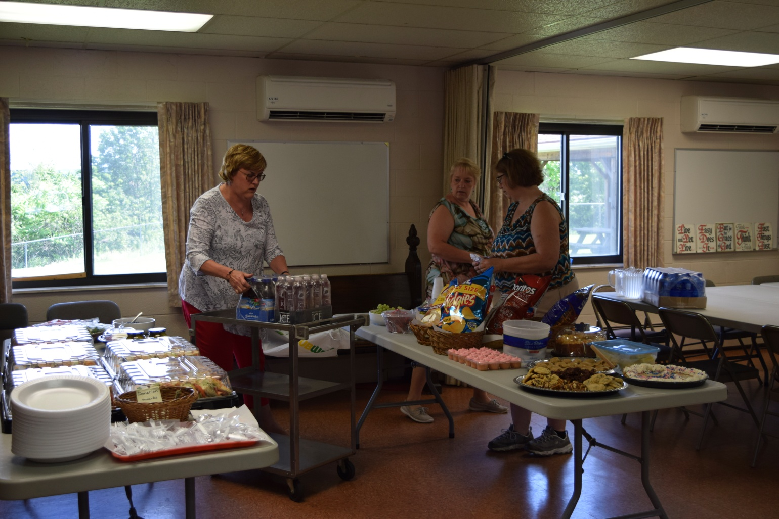
OUR SEND-OFF LUNCHEON
Thanks parents, grandparents & Donna
plus the Prontocks for our beverages

Slide 4
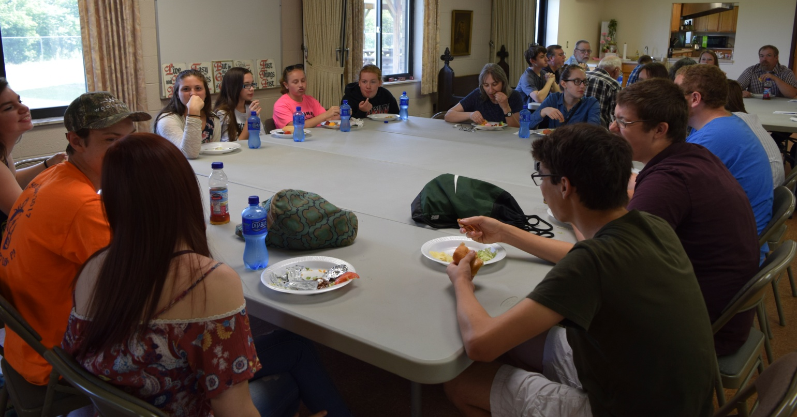
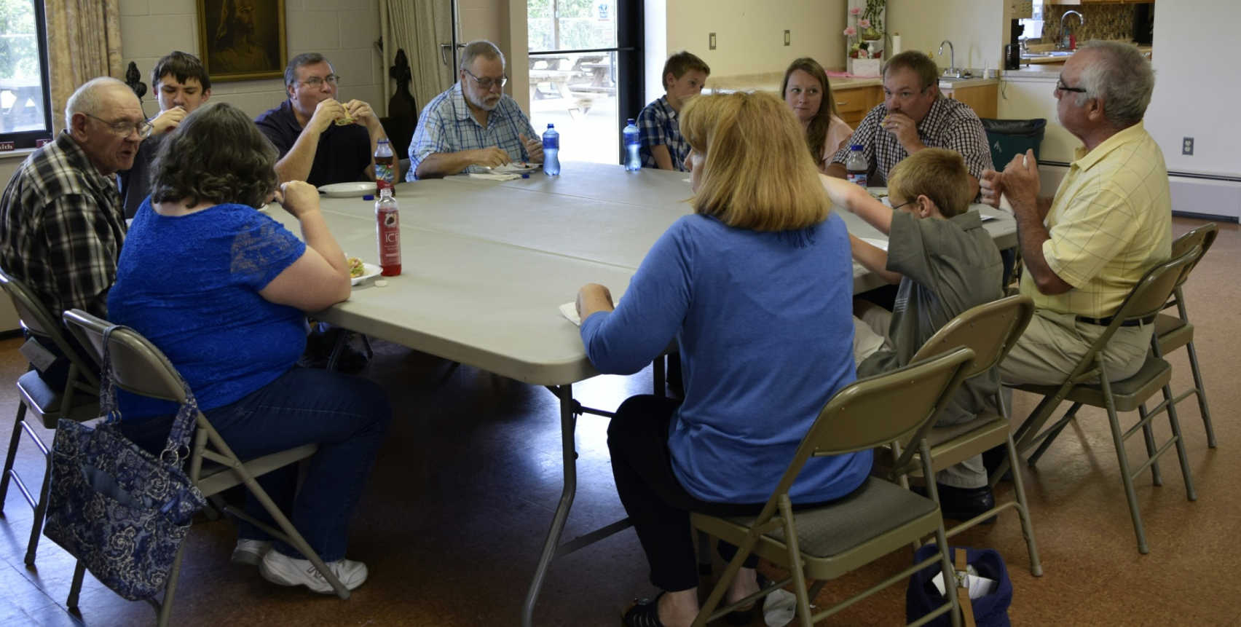

Slide 5
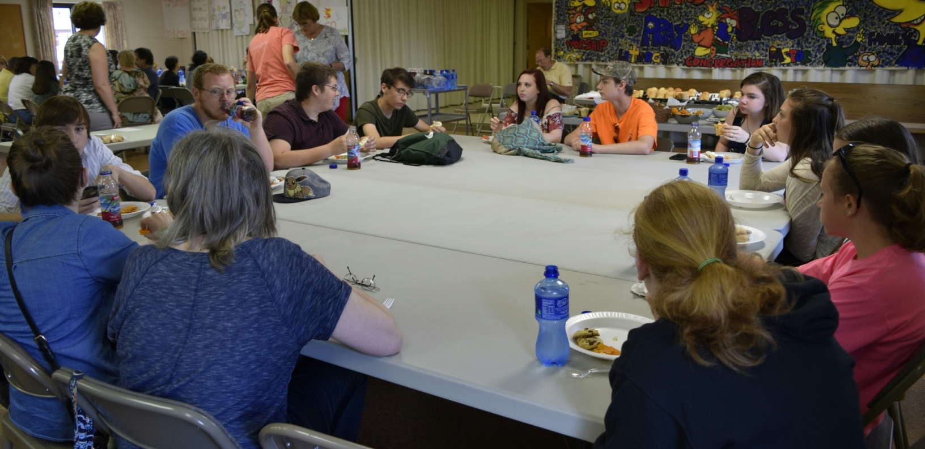
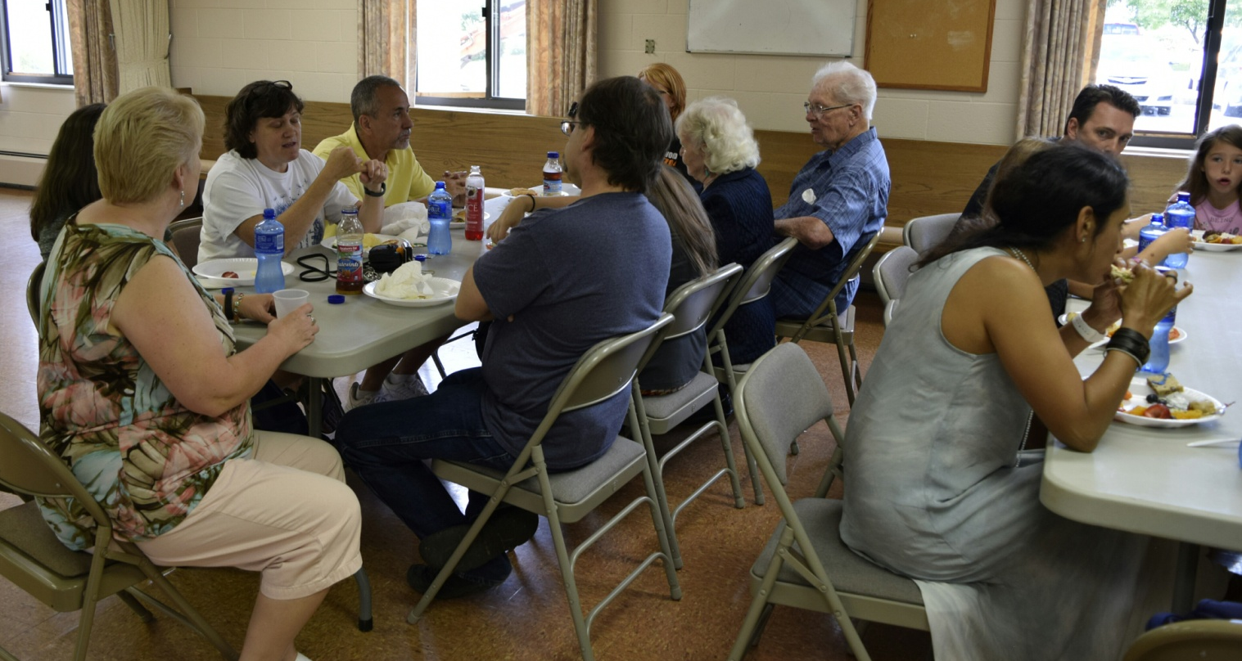

Slide 6
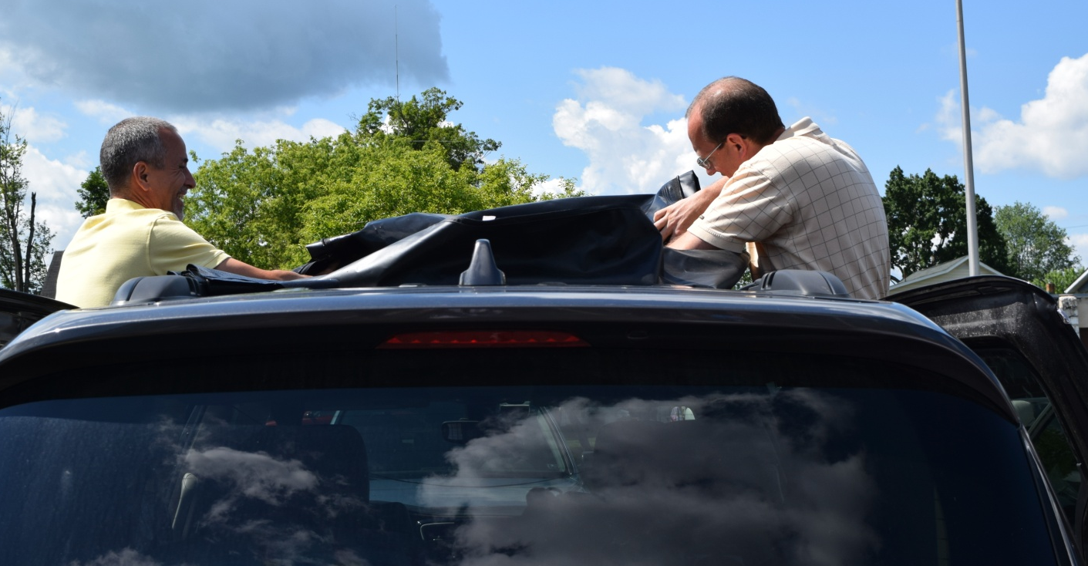
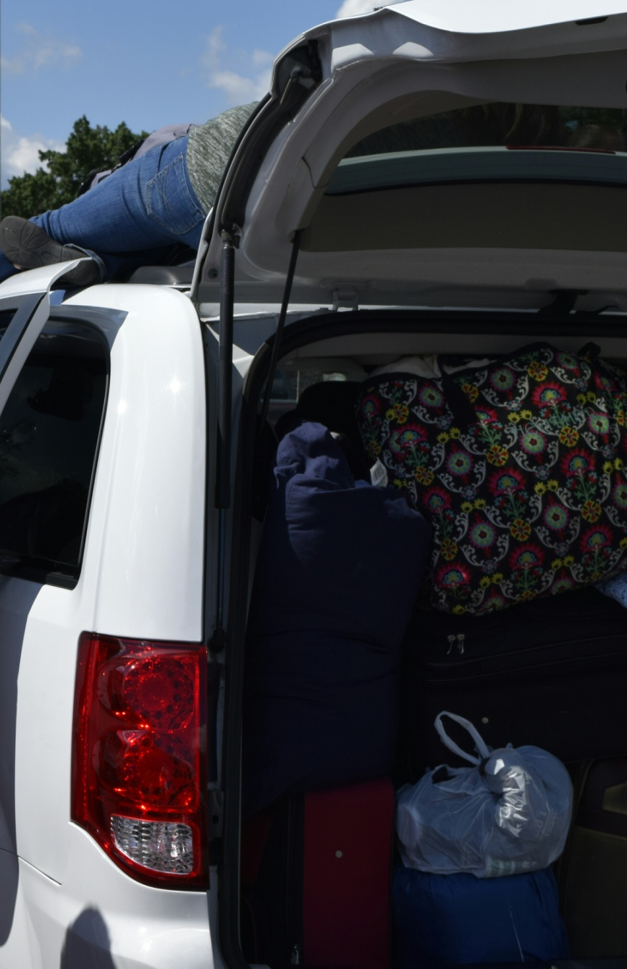
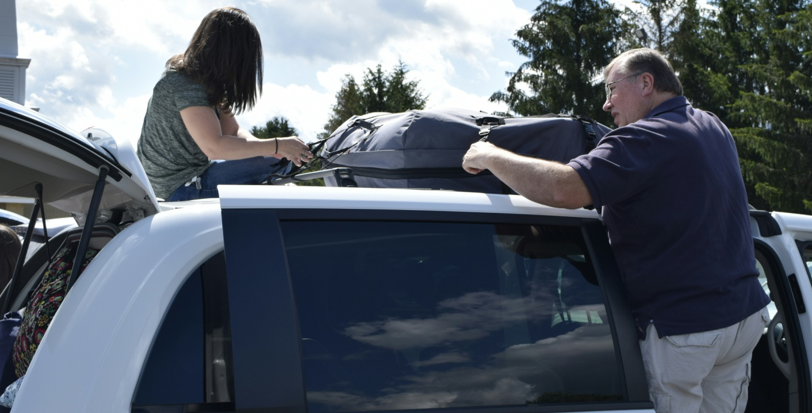
PACKED TO THE GILLS!

Slide 7
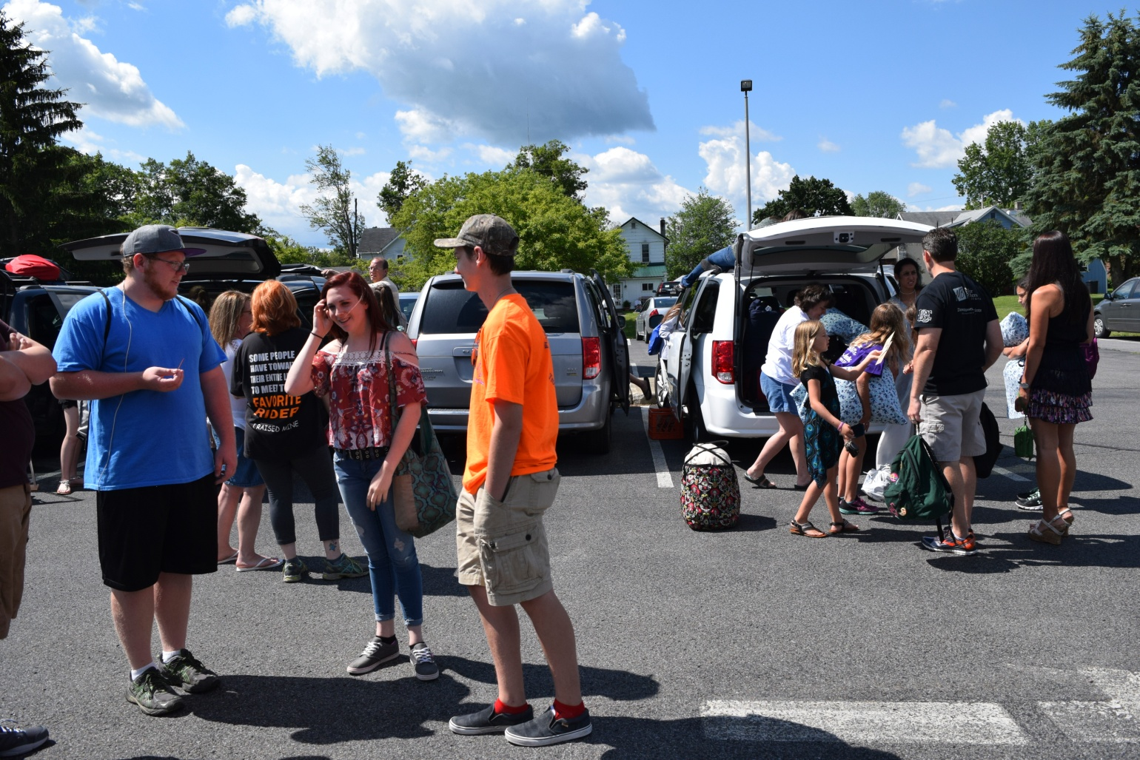

Slide 8
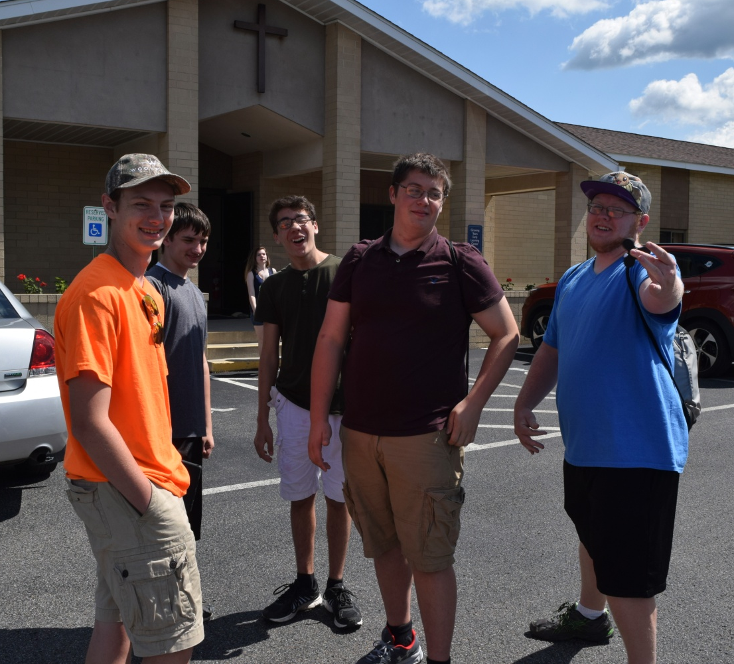

Slide 9
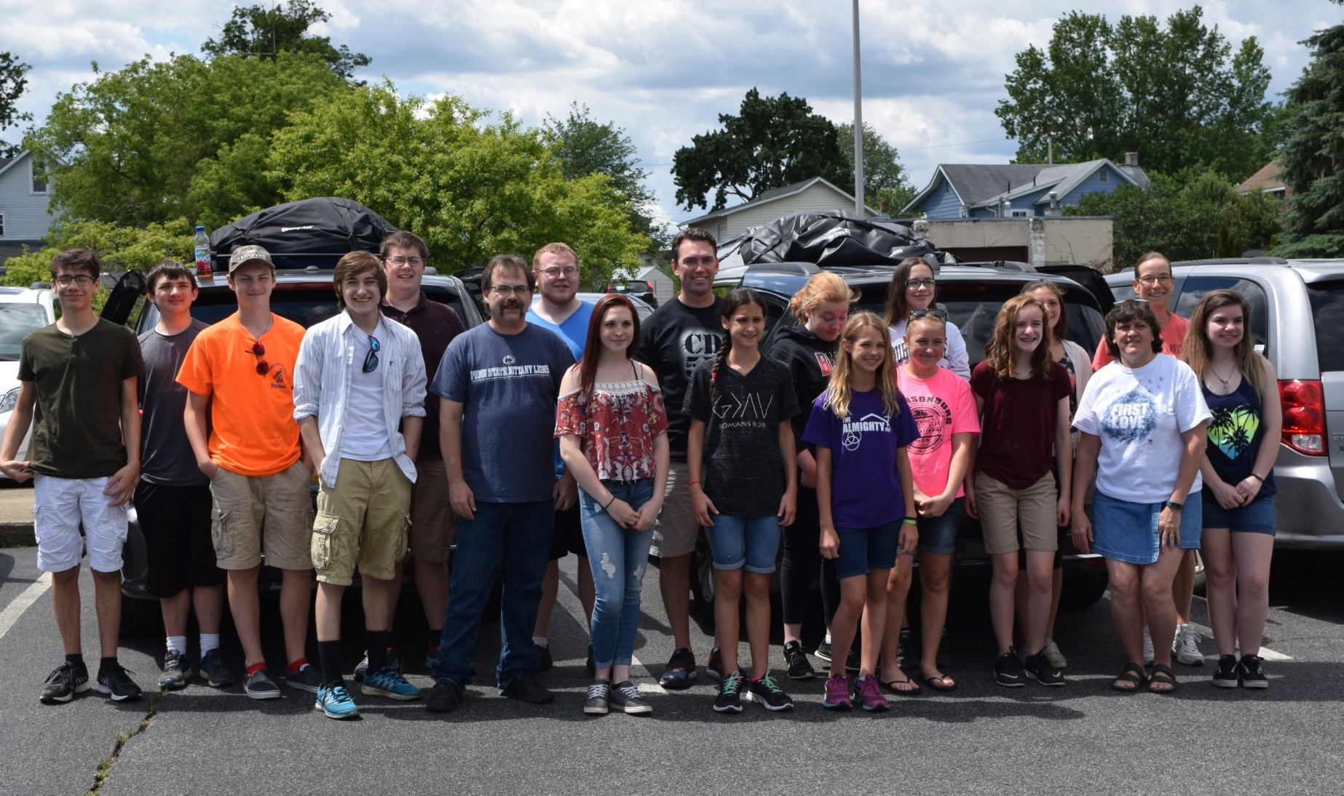
READY TO ROLL!!

Slide 10
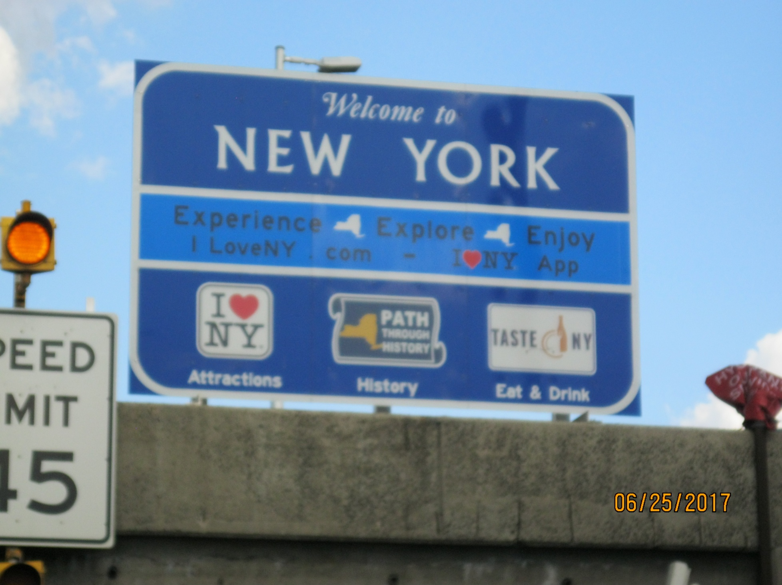
ON THE ROAD AGAIN!
We did spend lots of time on the road,
traffic was challenging, and parking...
well it is New York City!

Slide 11
OUR SERVICE SITES and WORK CREWS
On Sunday evening, Pastor Amy put our 4 adults and 15 youth into our assigned work crews.
Two of our groups worked with youth and an adult from other churches, two worked on their own.
Work crews were named for various Queens past and present!

Slide 12
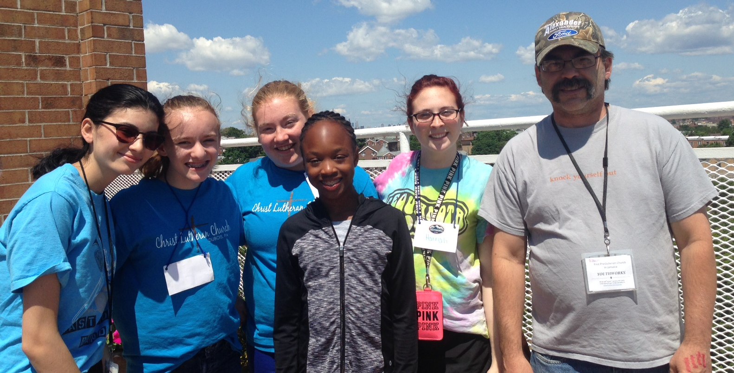
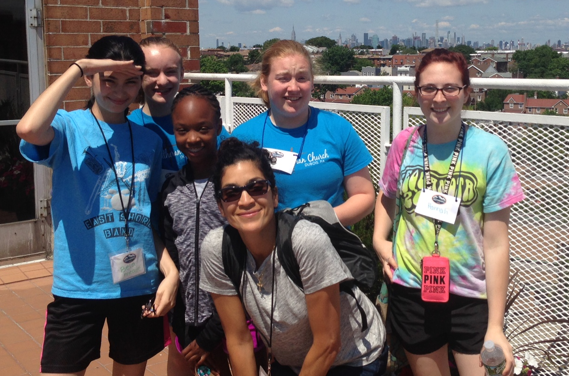
CLEOPATRA
WORK CREW
Jeff, Hannah, Kaylee & Ella
plus 3 new friends

Slide 13
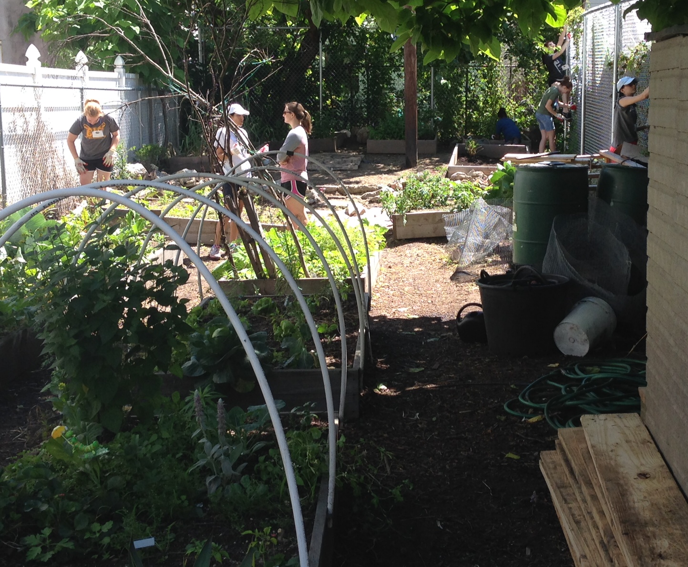
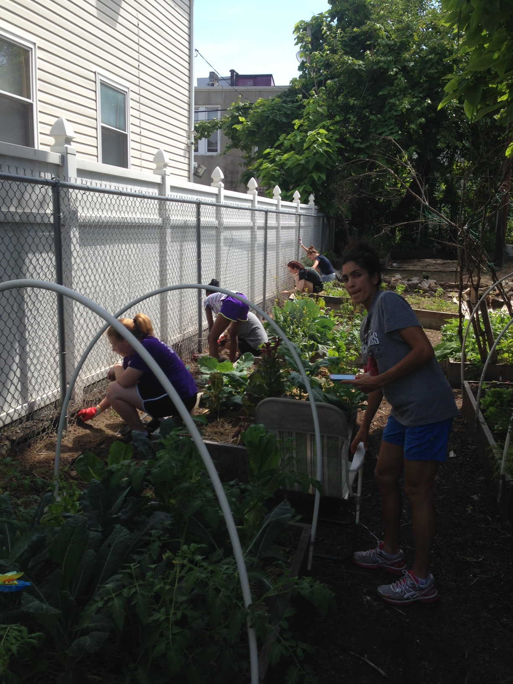
WORK IN A
COMMUNITY GARDEN

Slide 14
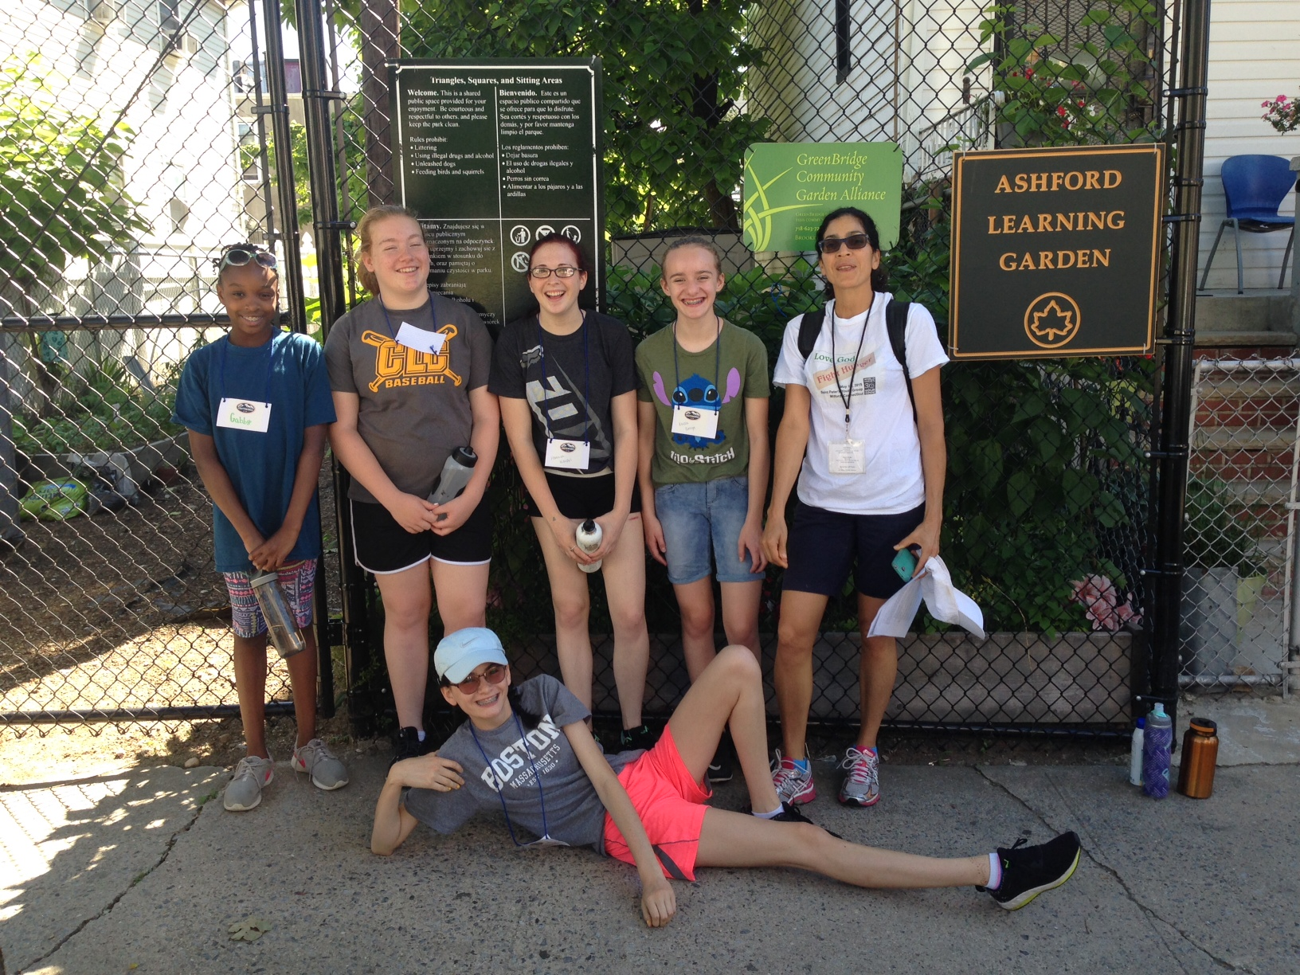

Slide 15
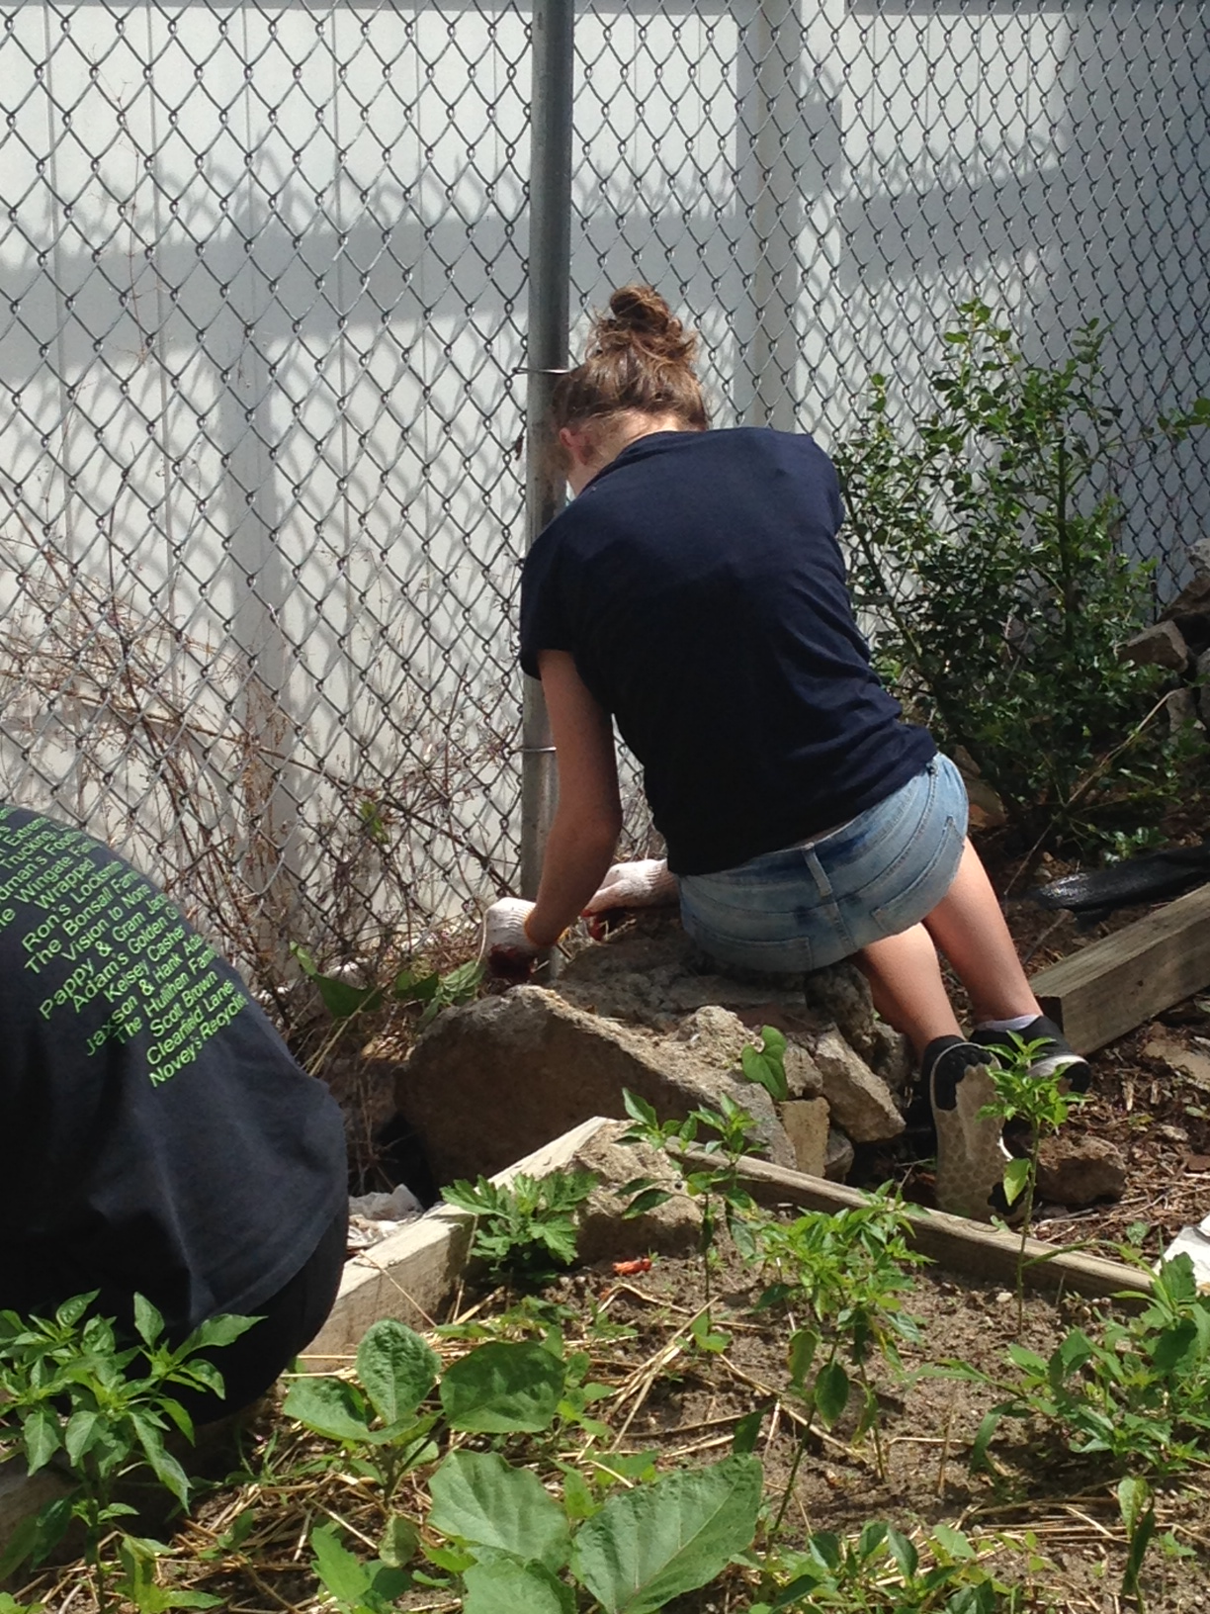
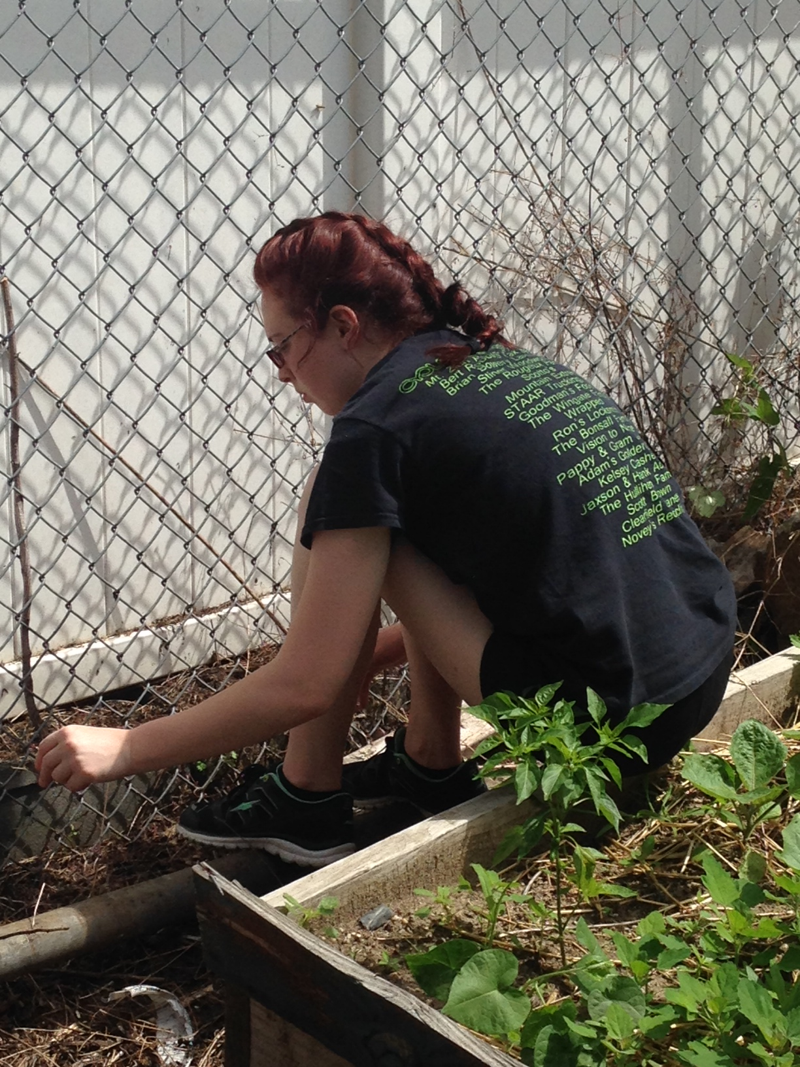

Slide 16
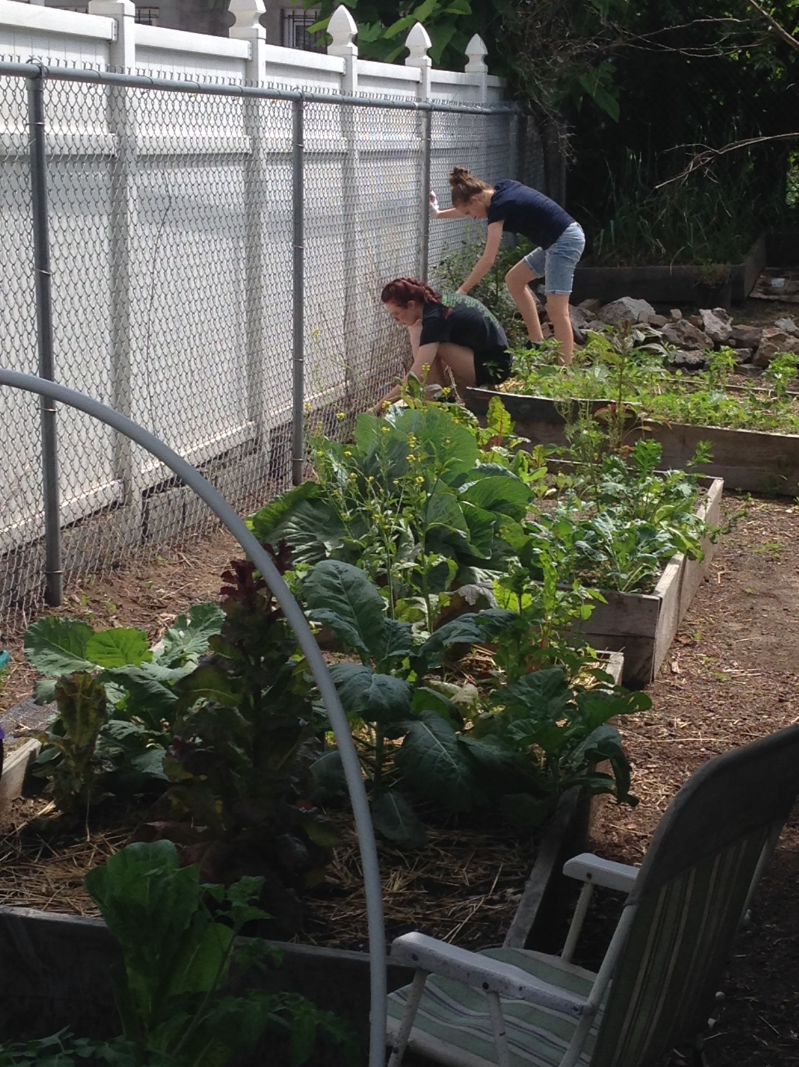
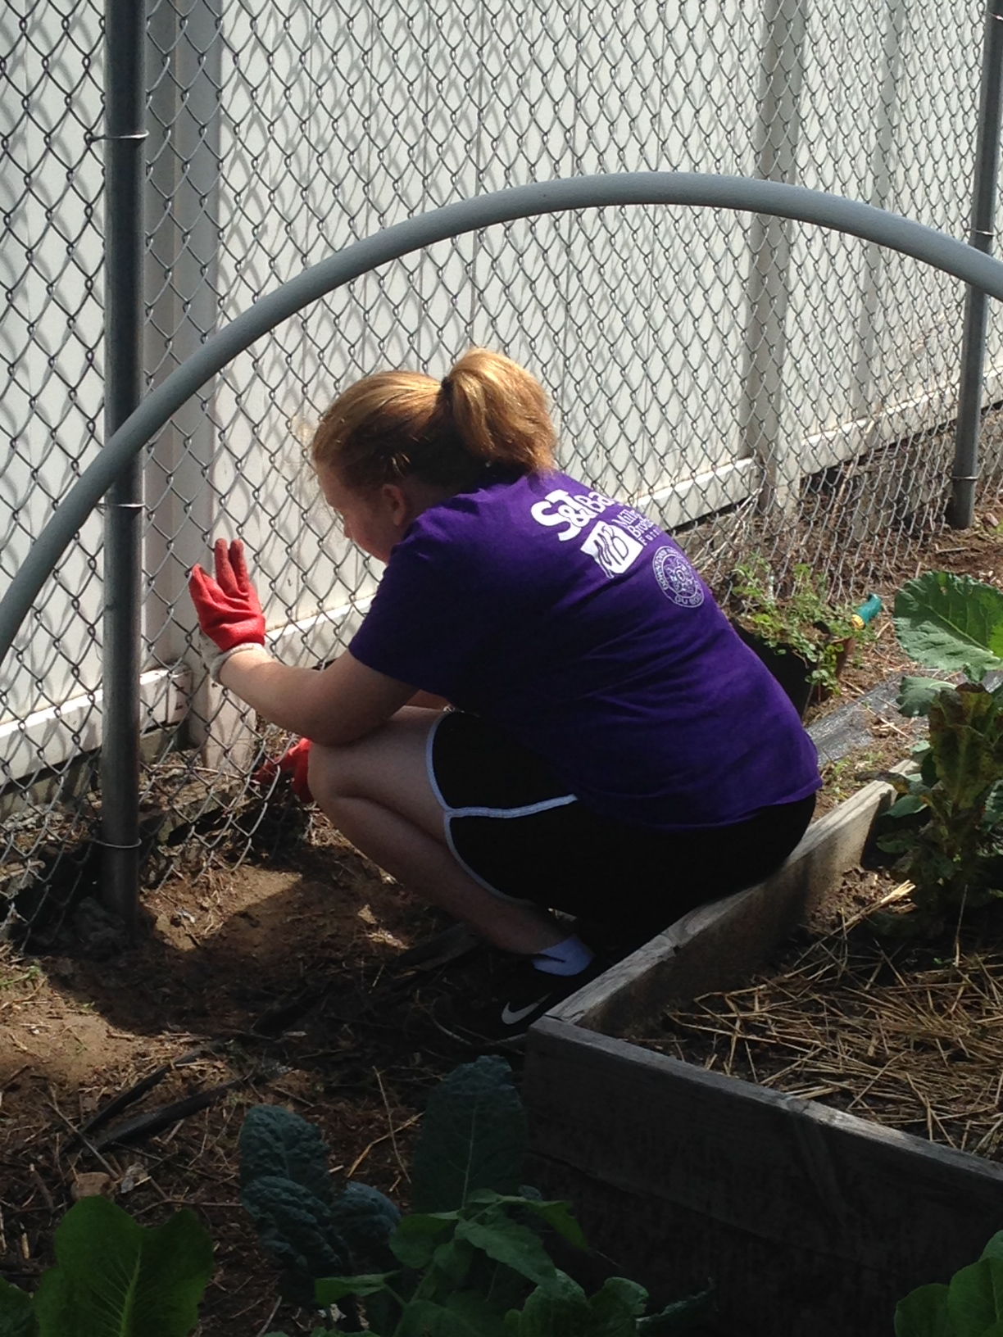

Slide 17
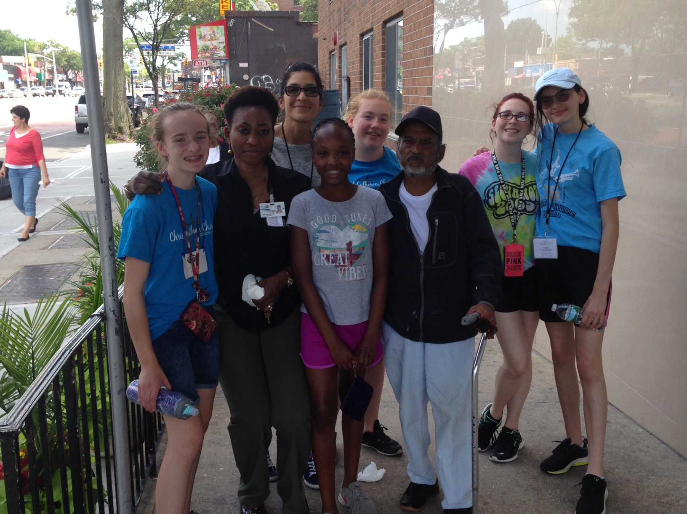
AND AT AN ASSISTED LIVING
FACILITY

Slide 18
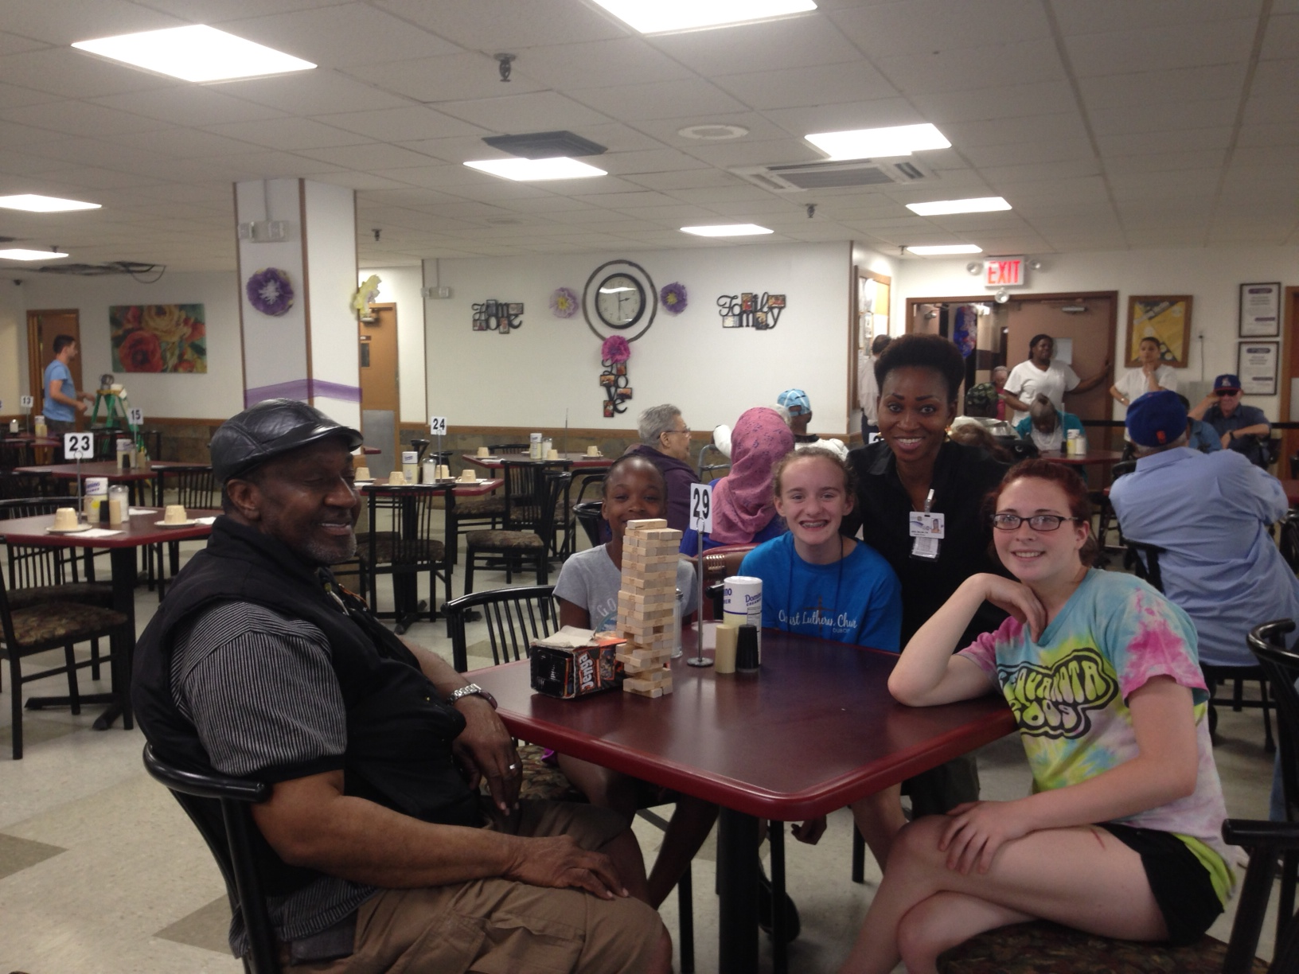

Slide 19
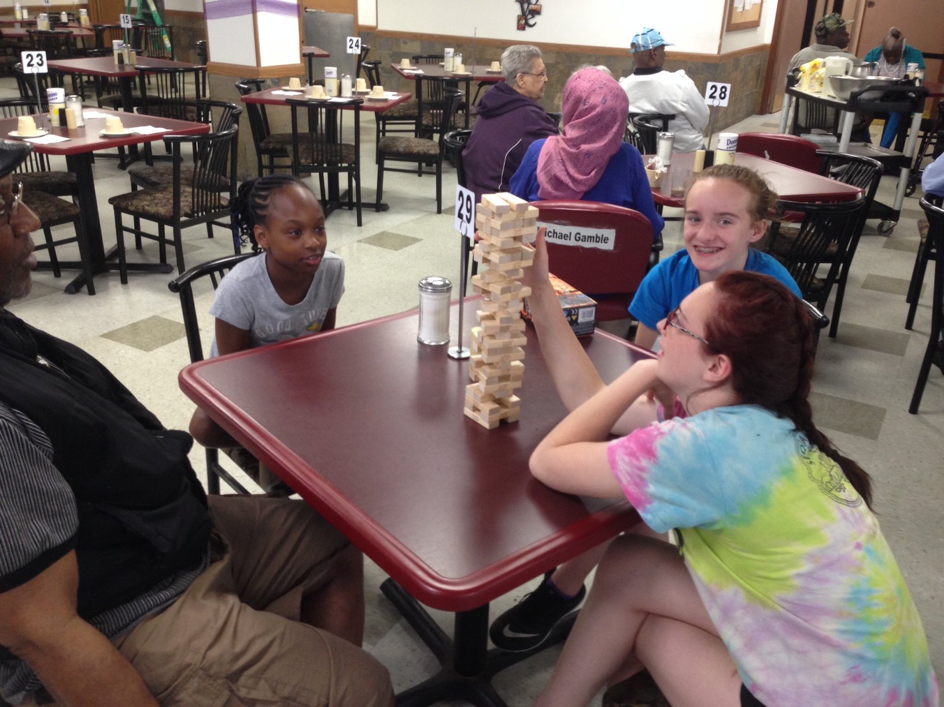

Slide 20
