Slide 1
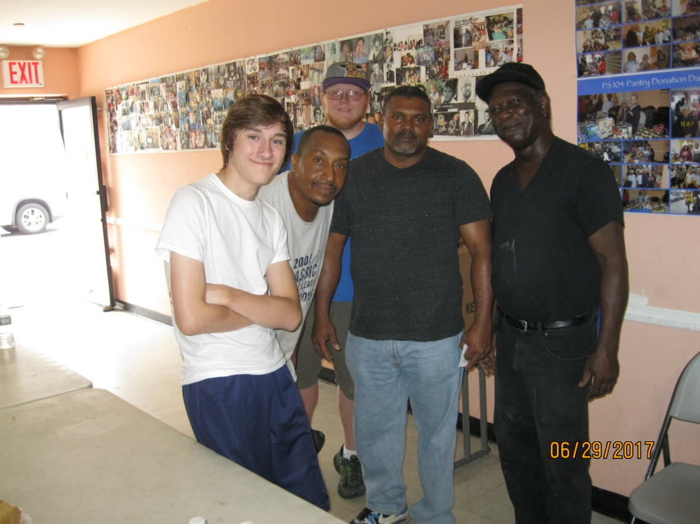

Slide 2
Troy and Ann Marie were two of the lead volunteers. It was Ann Marie’s birthday while we were there and we gave her this gift ...

Slide 3
She loved it
and wore it the rest of the day!

Slide 4
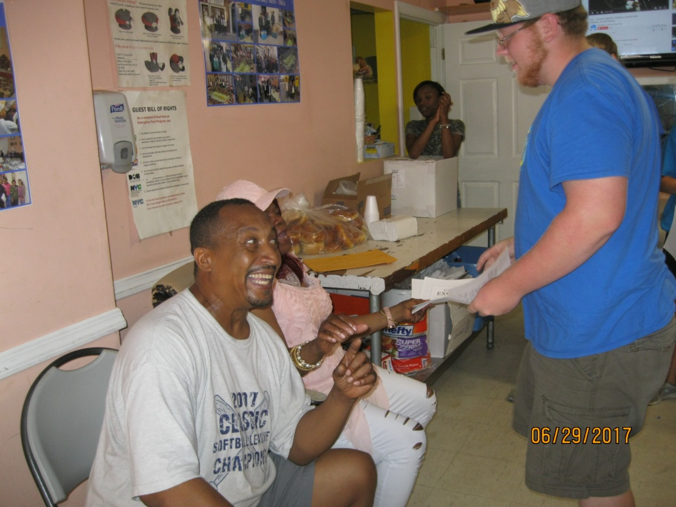

Slide 5
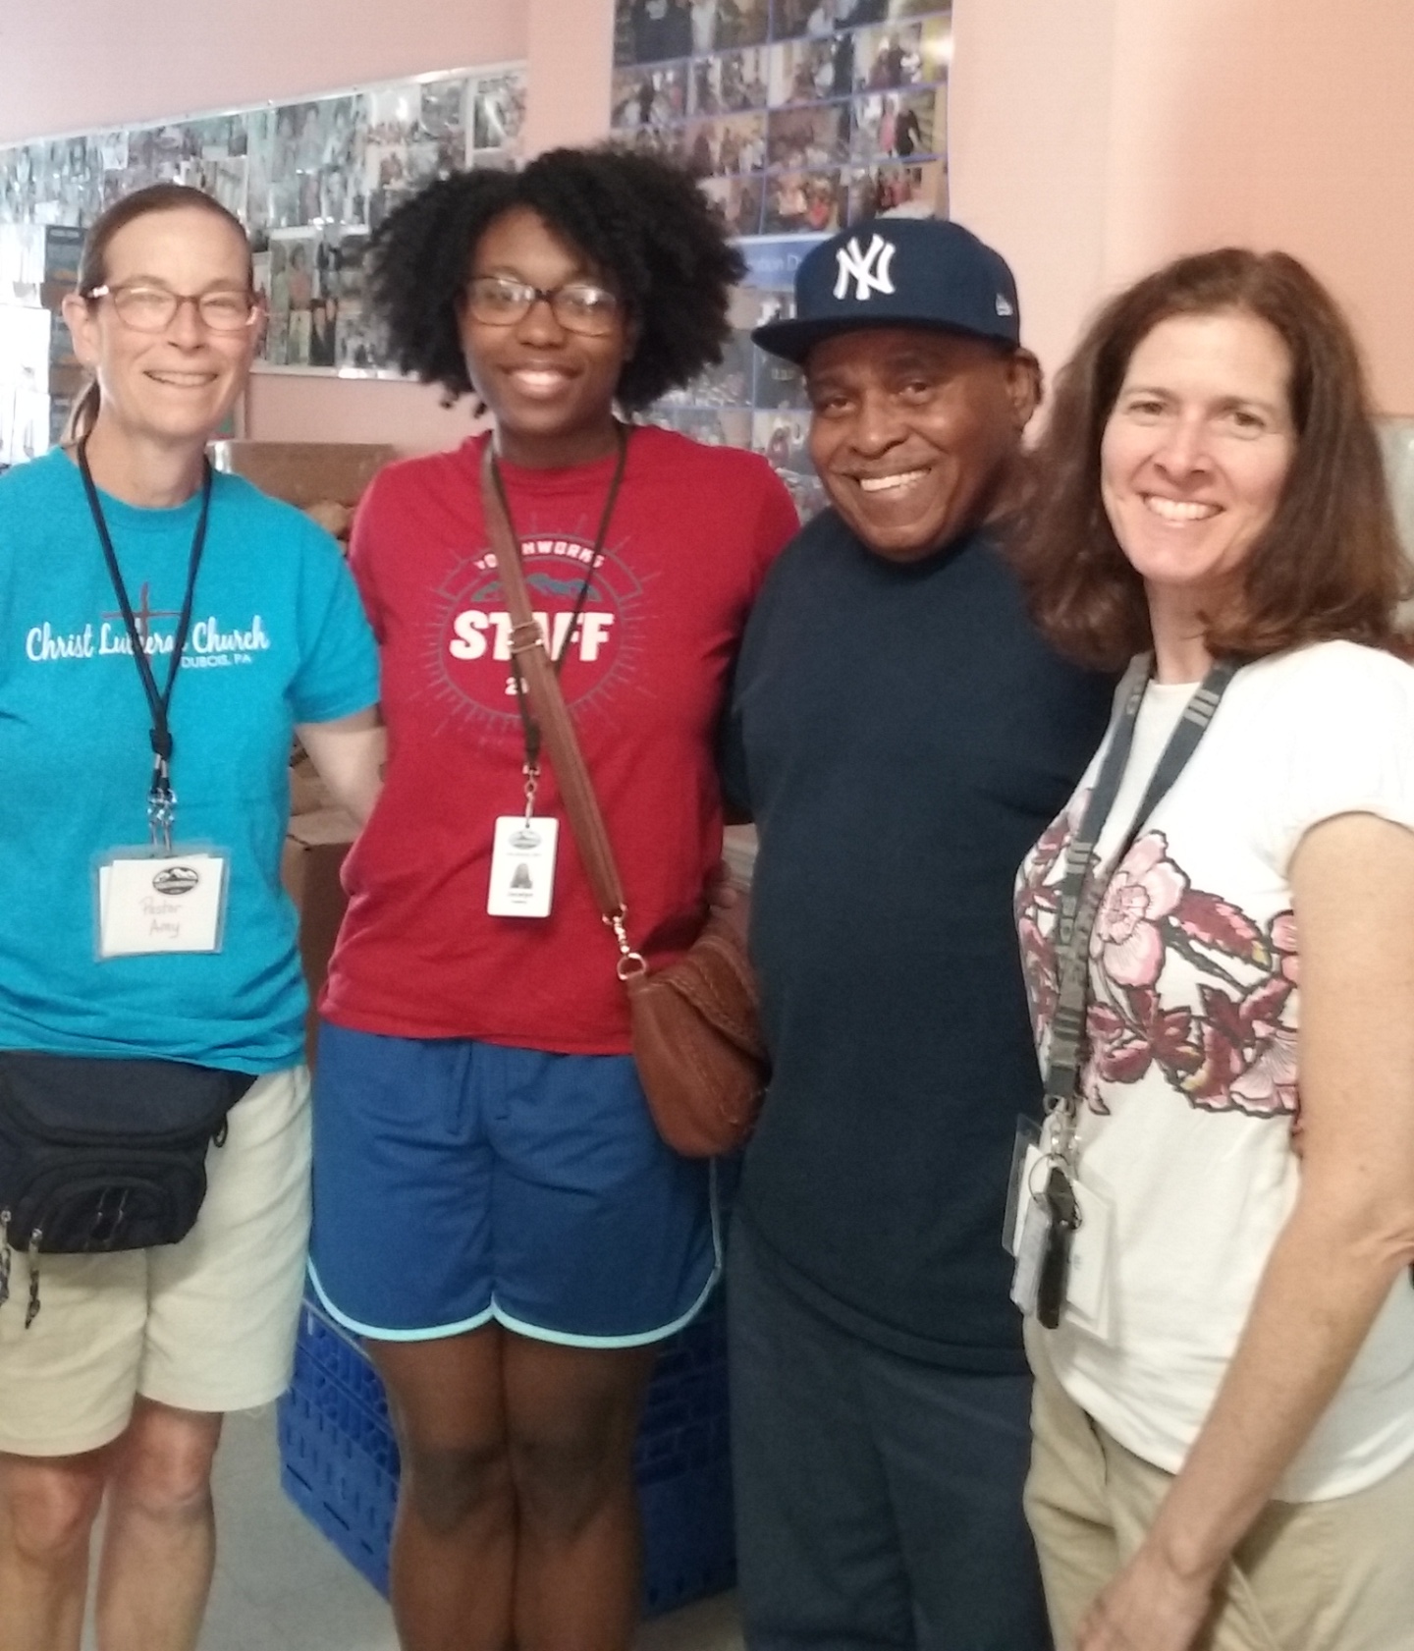

Slide 6
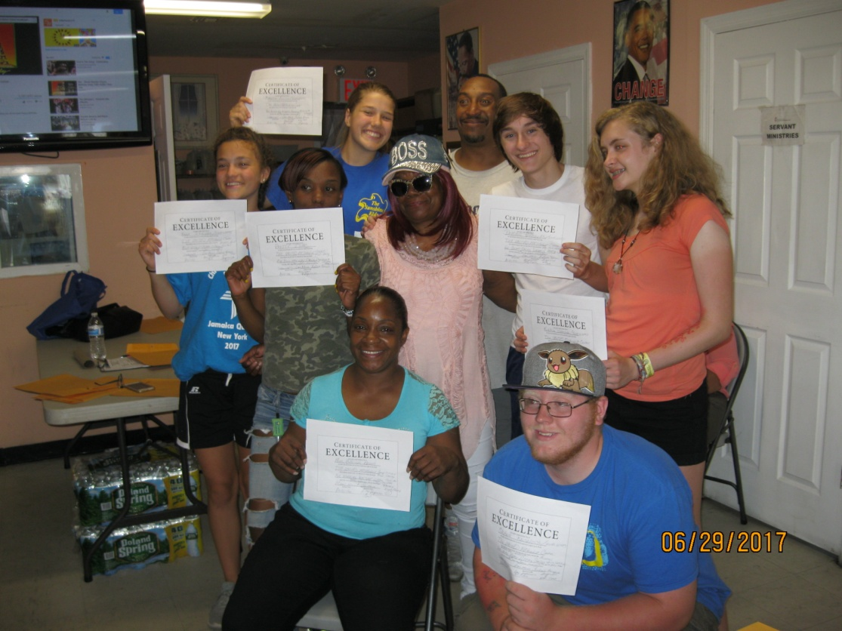

Slide 7
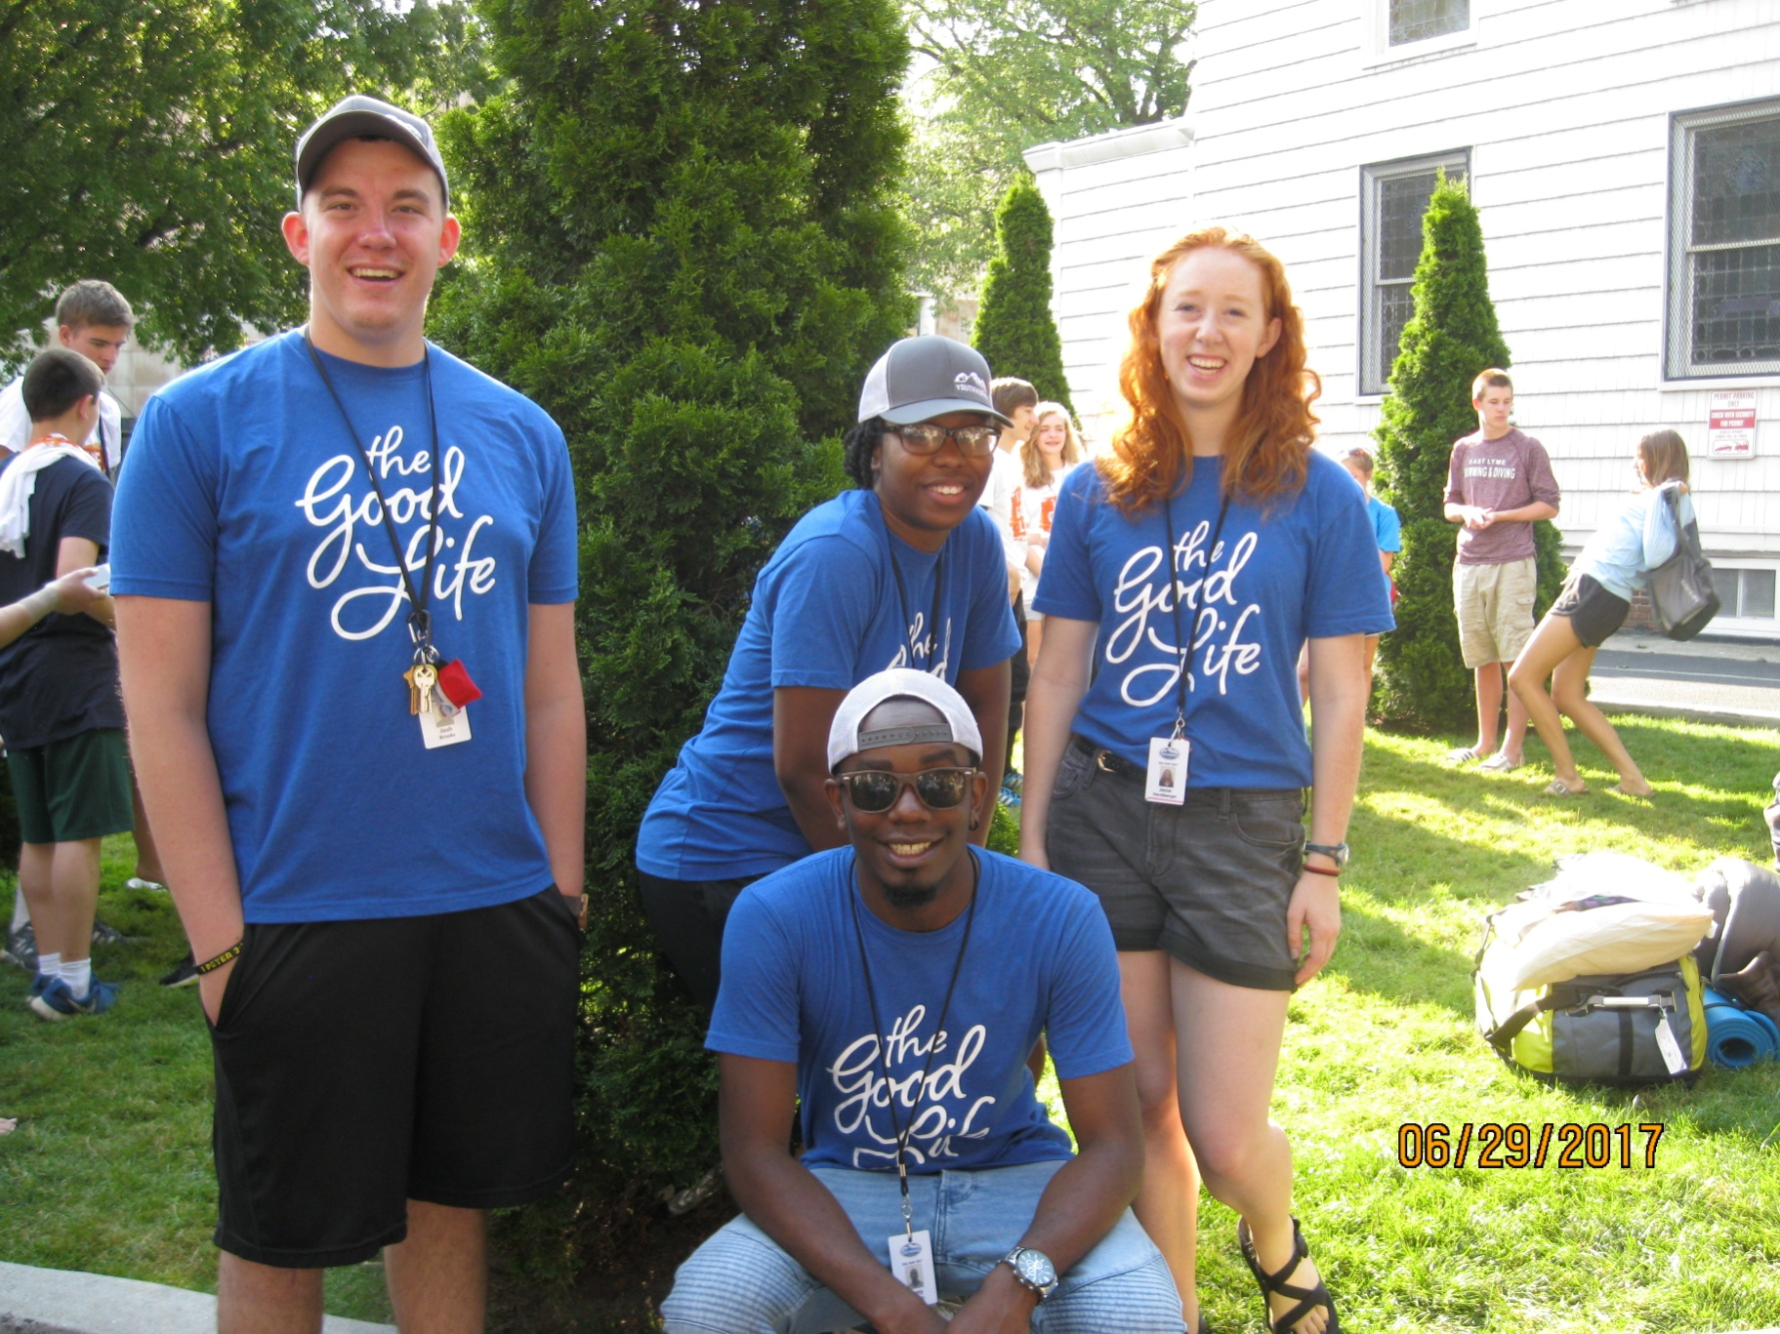
Here are our YOUTHWORKS LEADERS!
They coordinate and run the whole thing:
Josh, Jocelyn, Jesse and Lanny

Slide 8
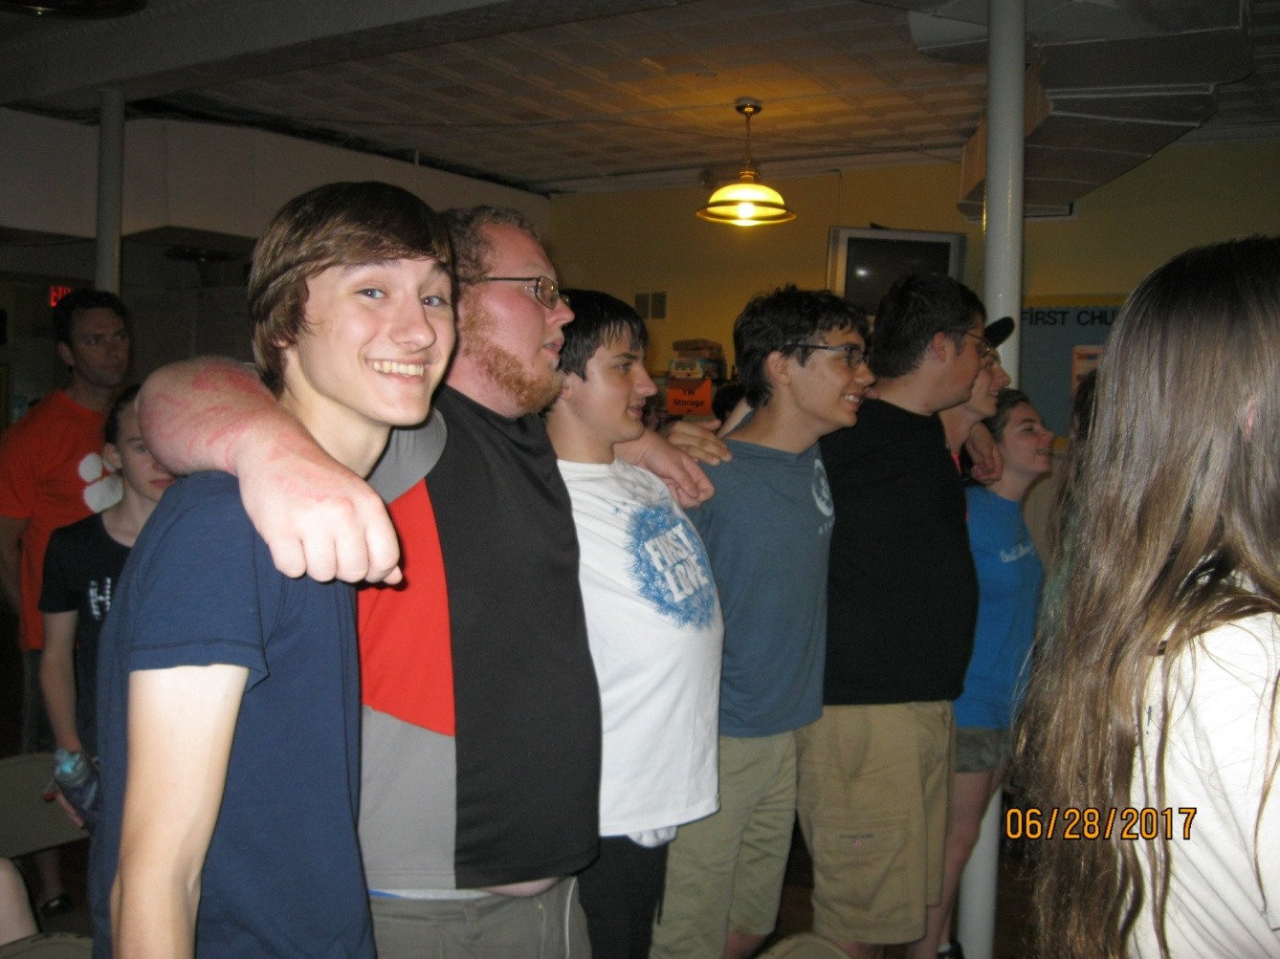
We worshipped together

Slide 9
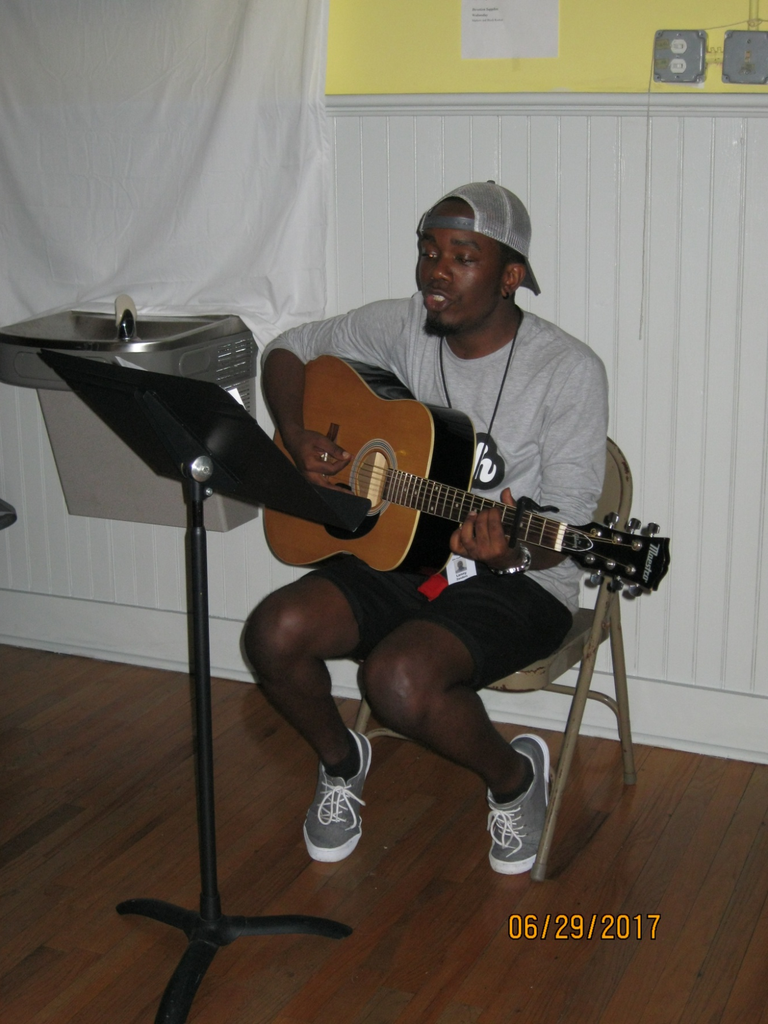

Slide 10
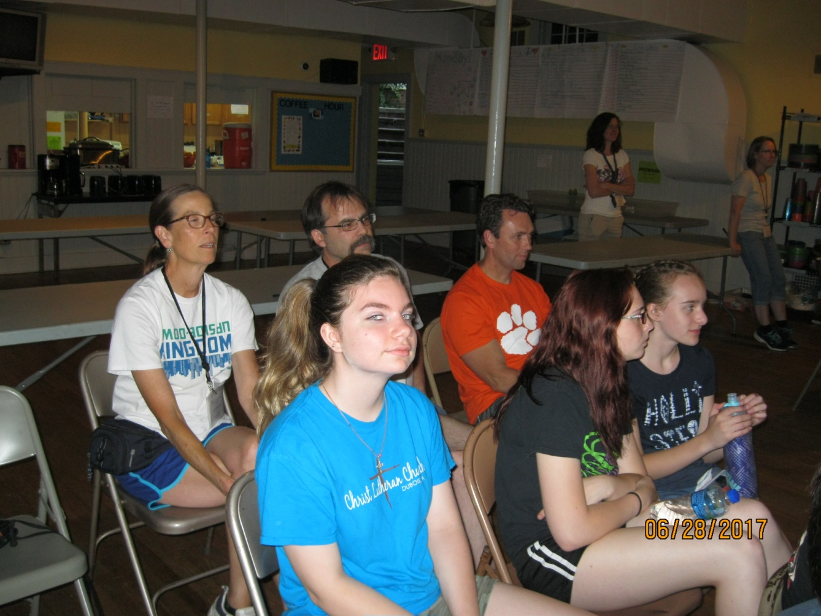

Slide 11
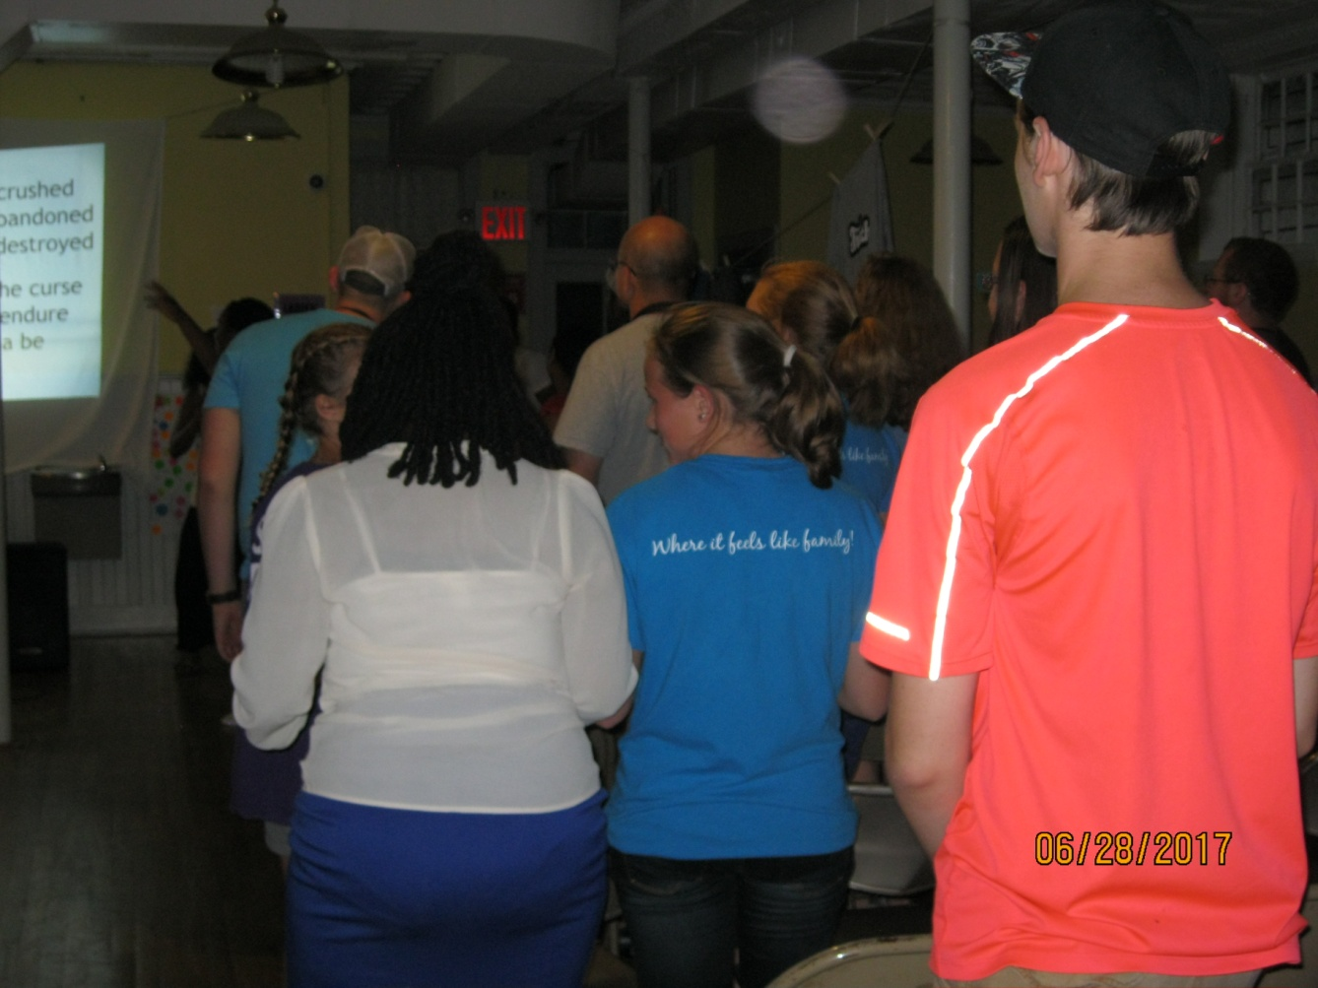

Slide 12
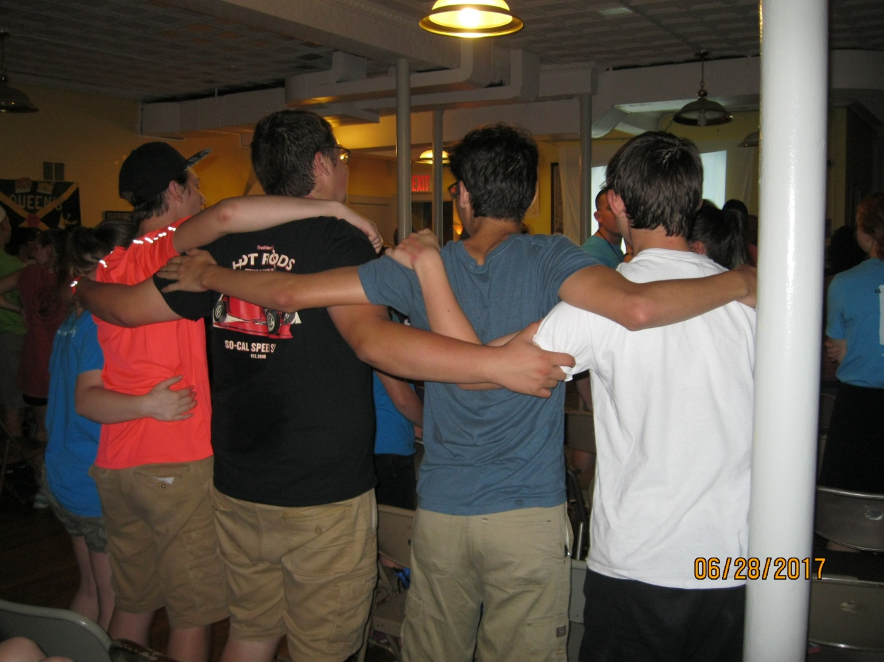

Slide 13
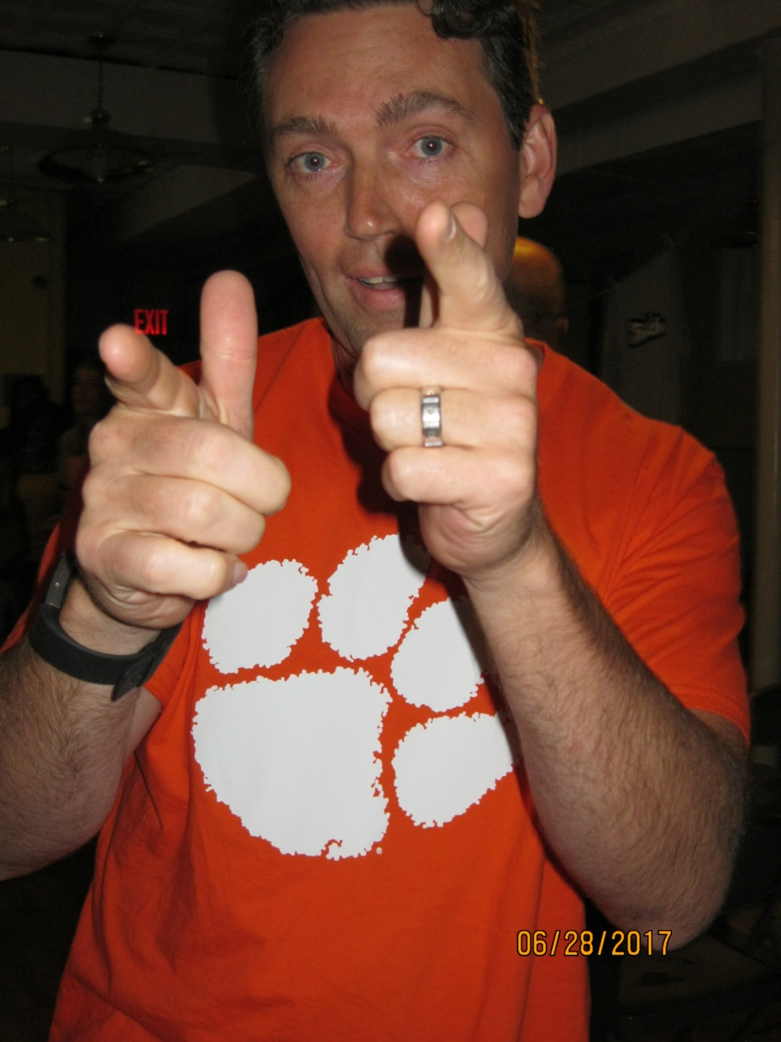
And we DANCED!

Slide 14
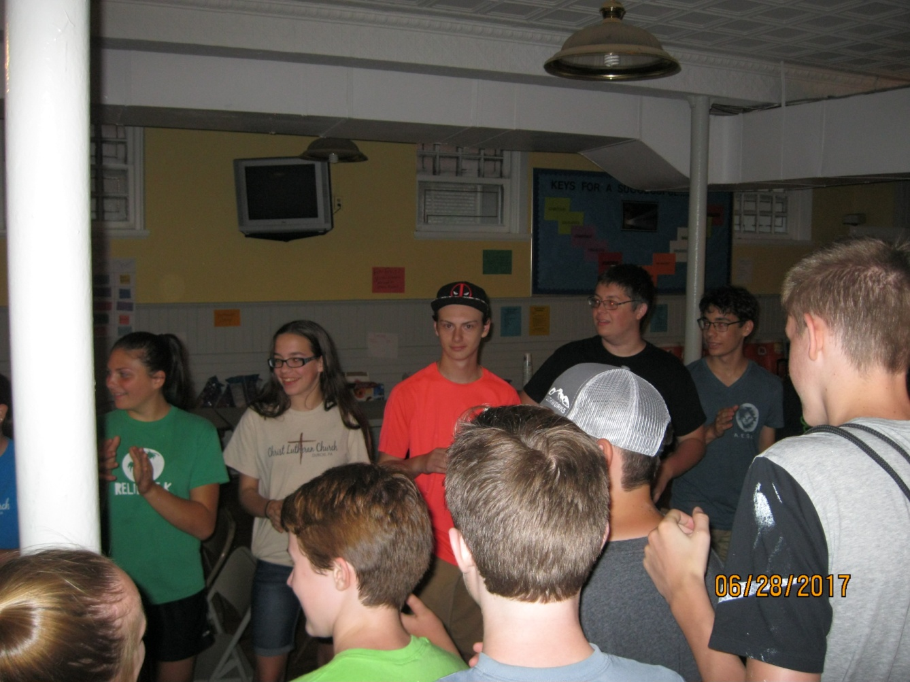

Slide 15
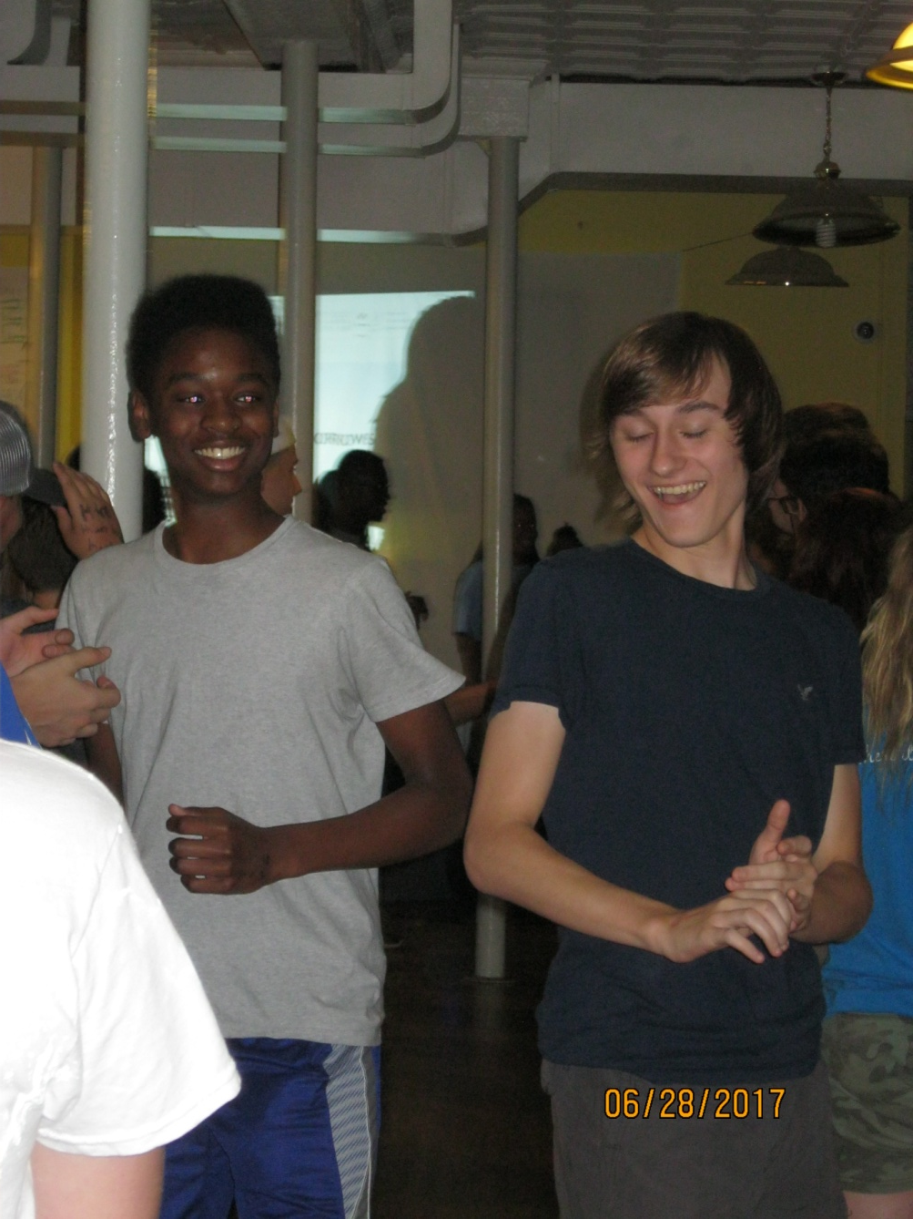

Slide 17
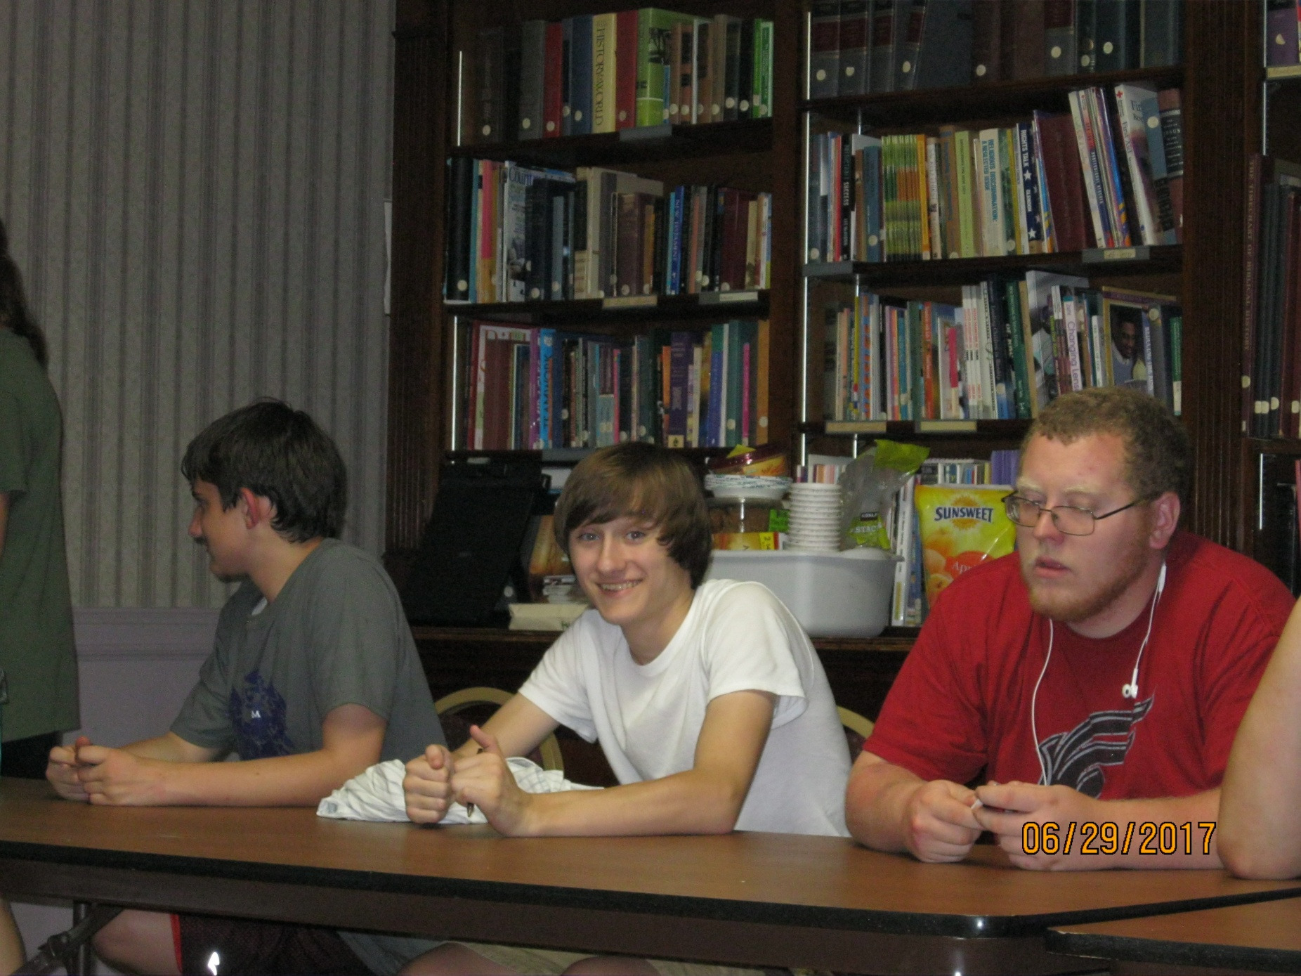
Had some Christ Church Family Time

Slide 18
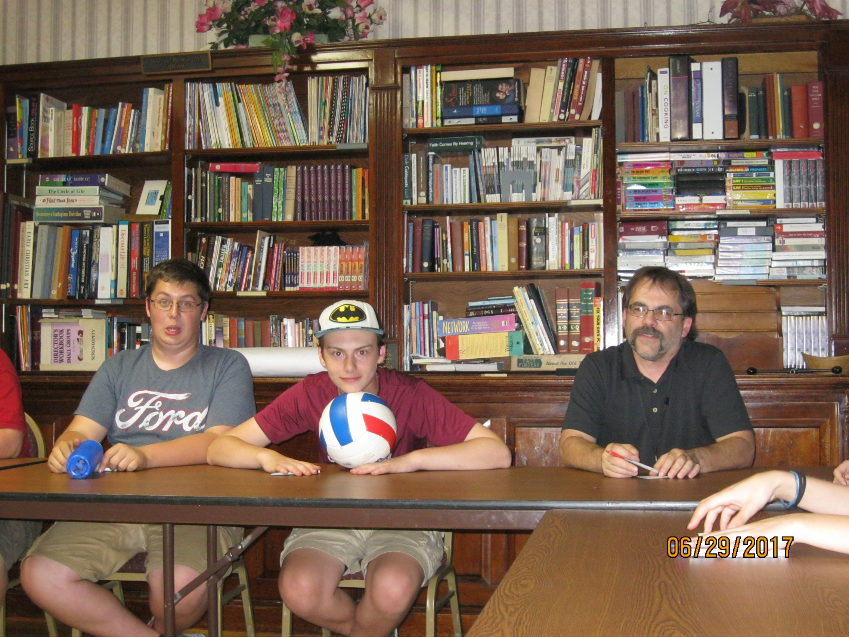

Slide 19
