Slide 1
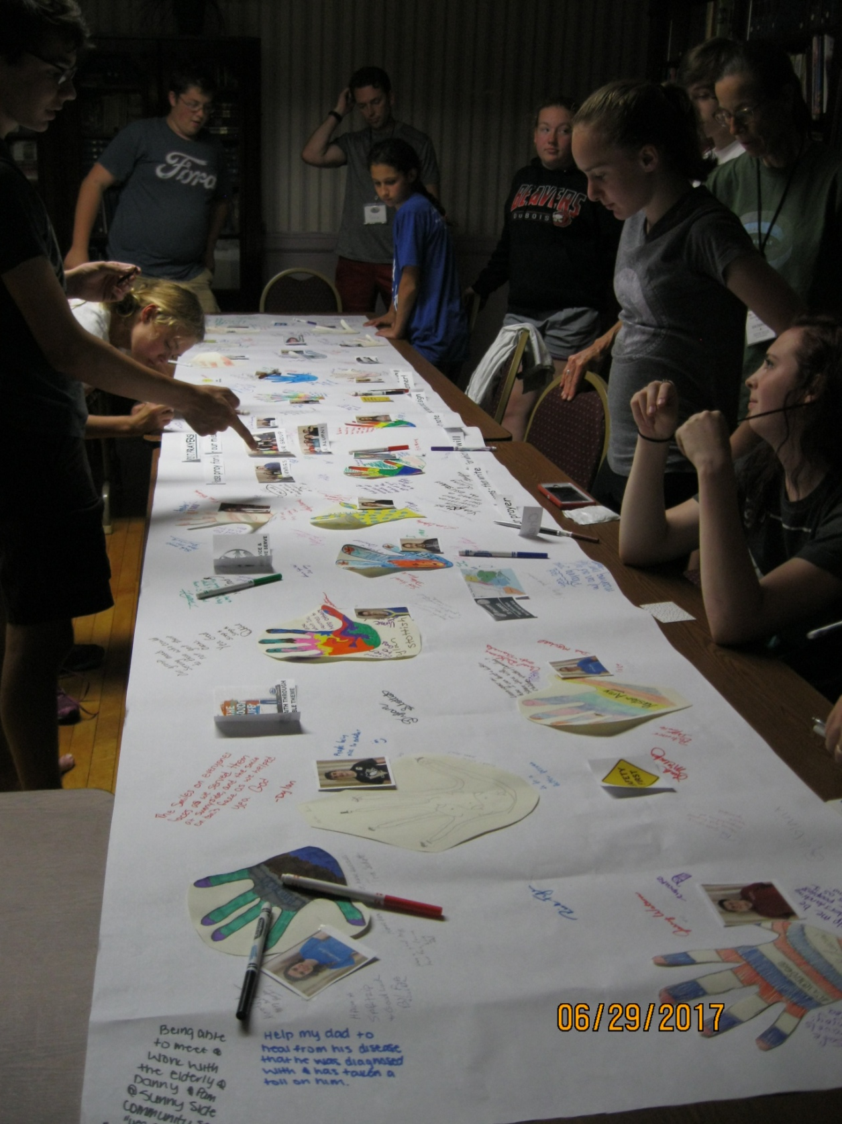
USED OUR
PRAYER BANNER –
To process all we were doing
and learning.
And to remember
YOUR THOUGHTS AND PRAYERS for us!
Thank you!

Slide 2
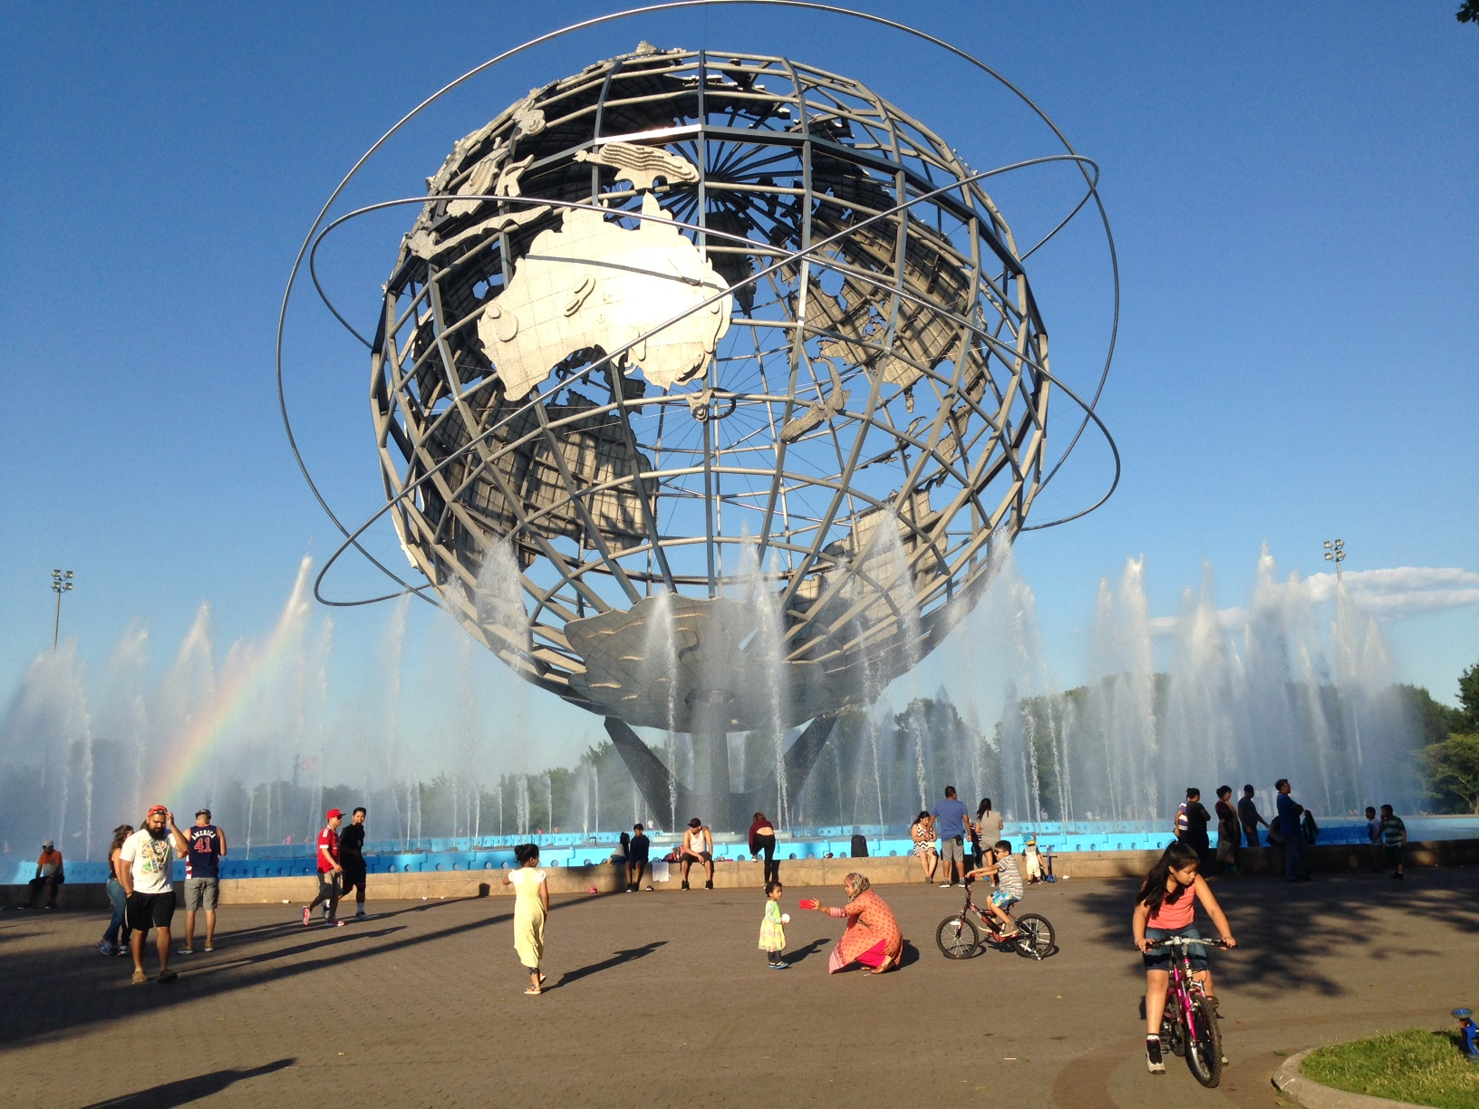
And several evening activities: Corona Park – site of the 1964 World’s Fair

Slide 3
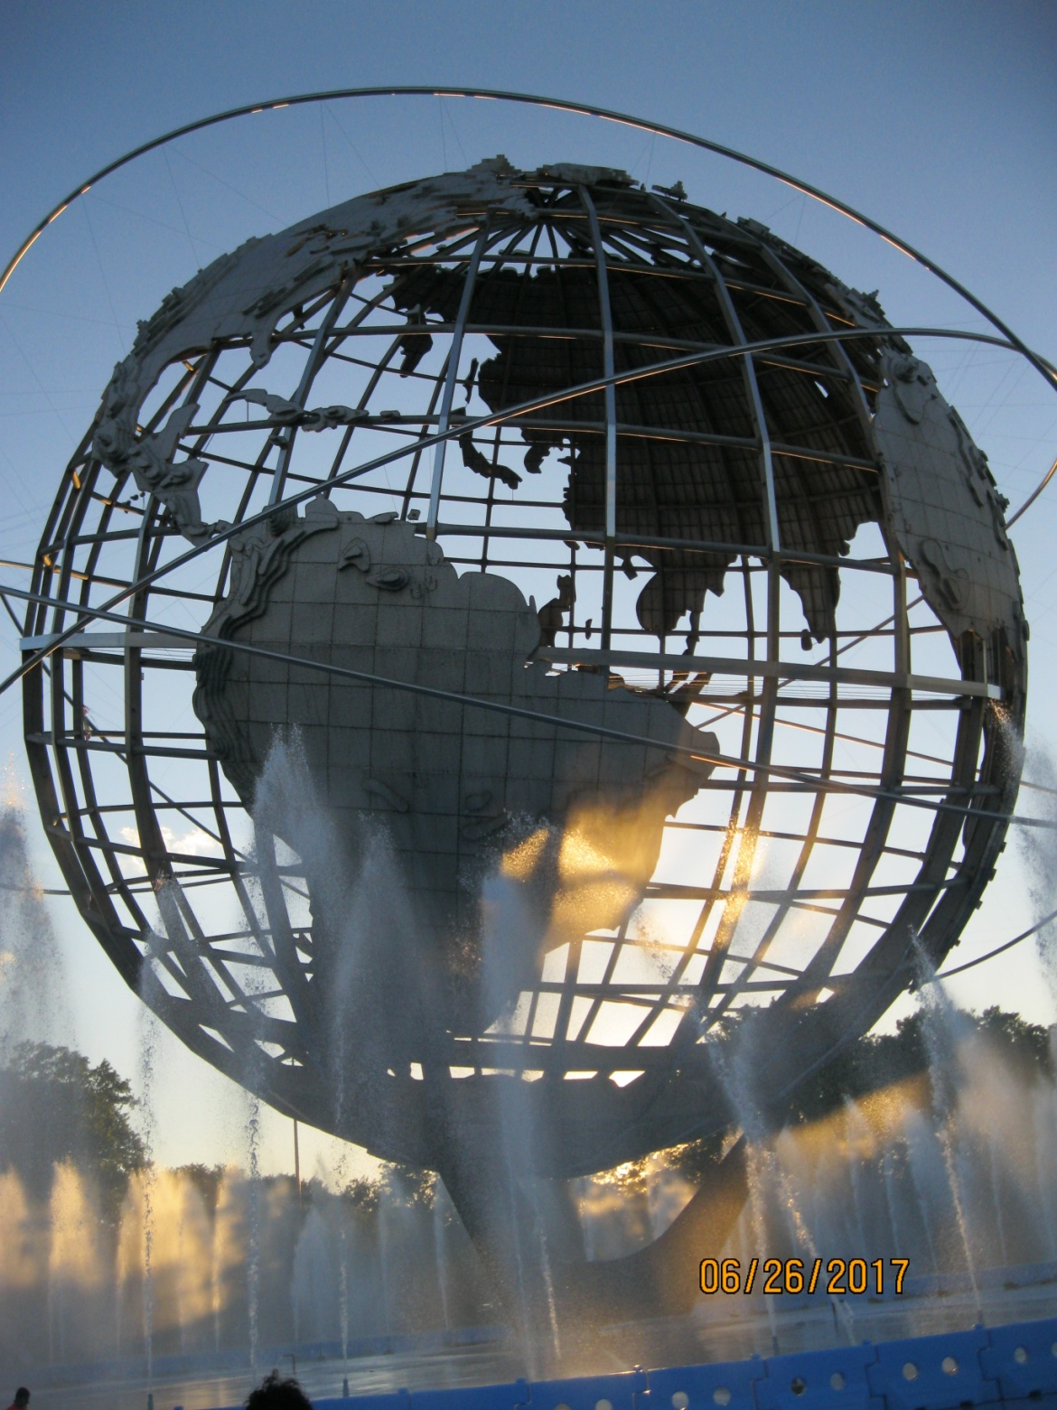

Slide 4
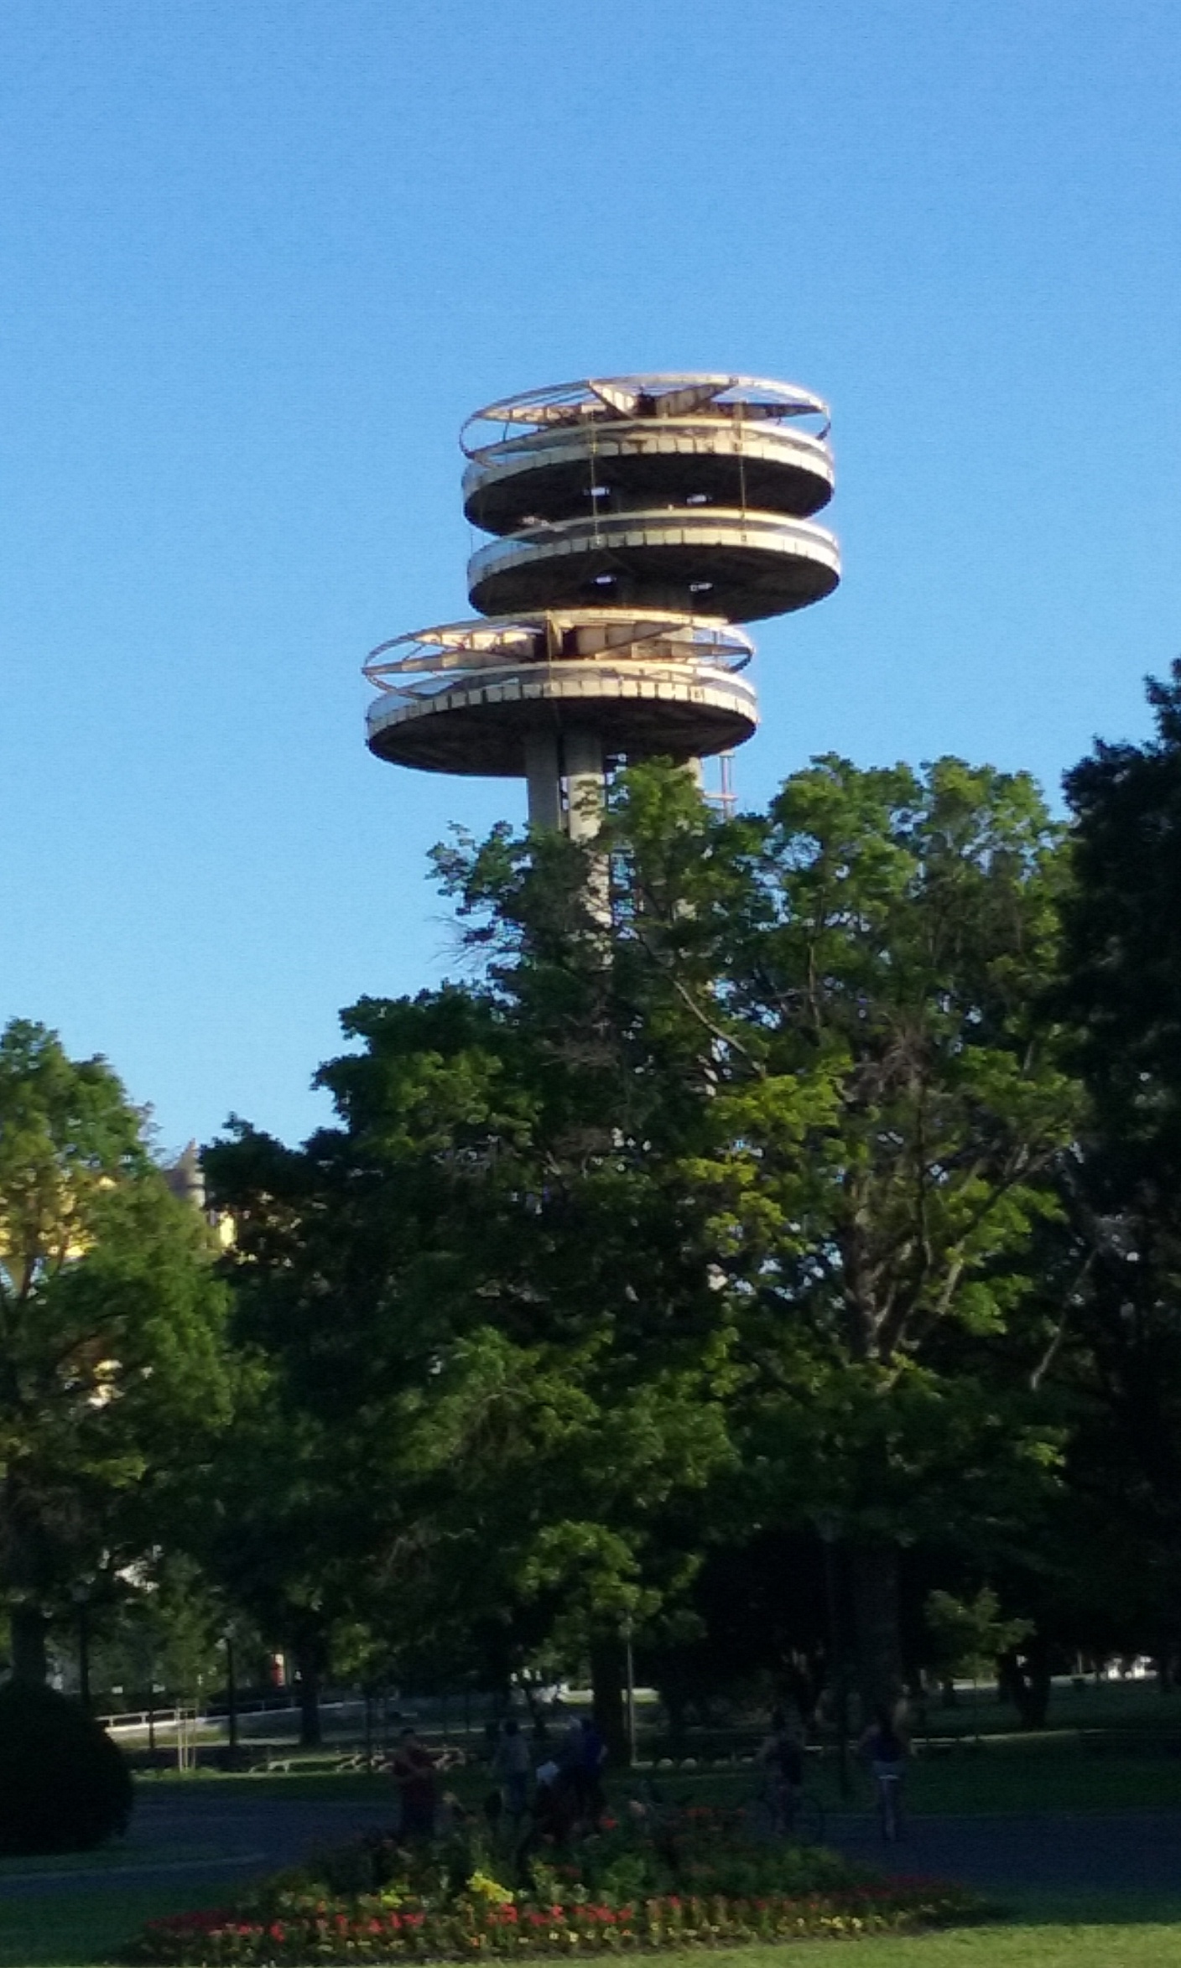

Slide 5
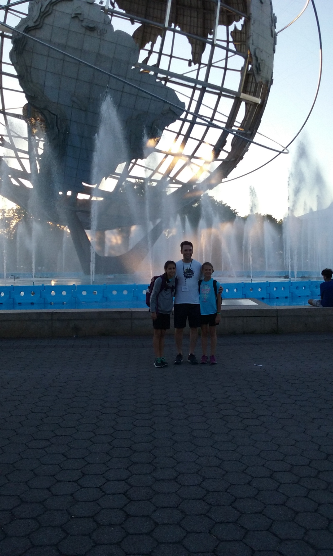

Slide 6
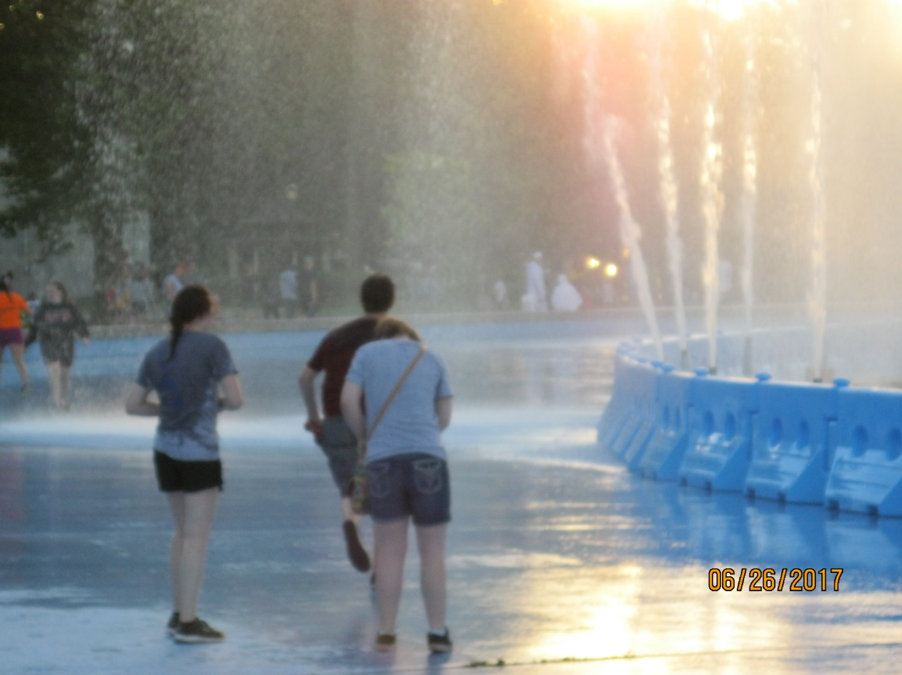

Slide 7
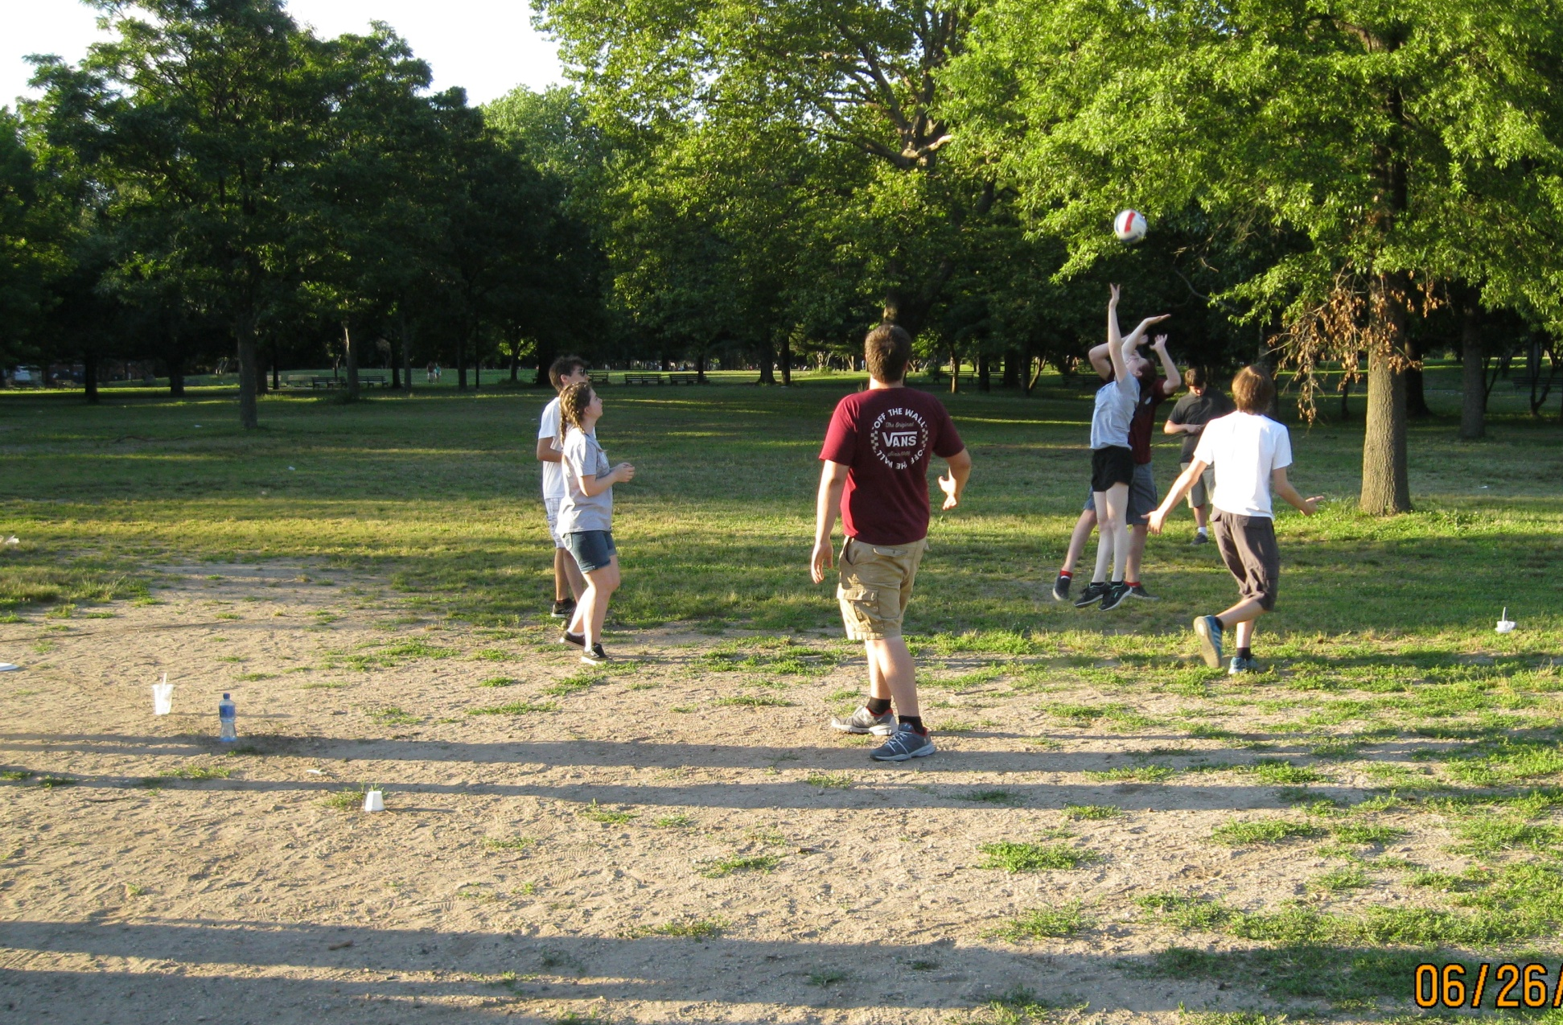
Where we created a new game – no net volleyball! We played it all week!

Slide 8
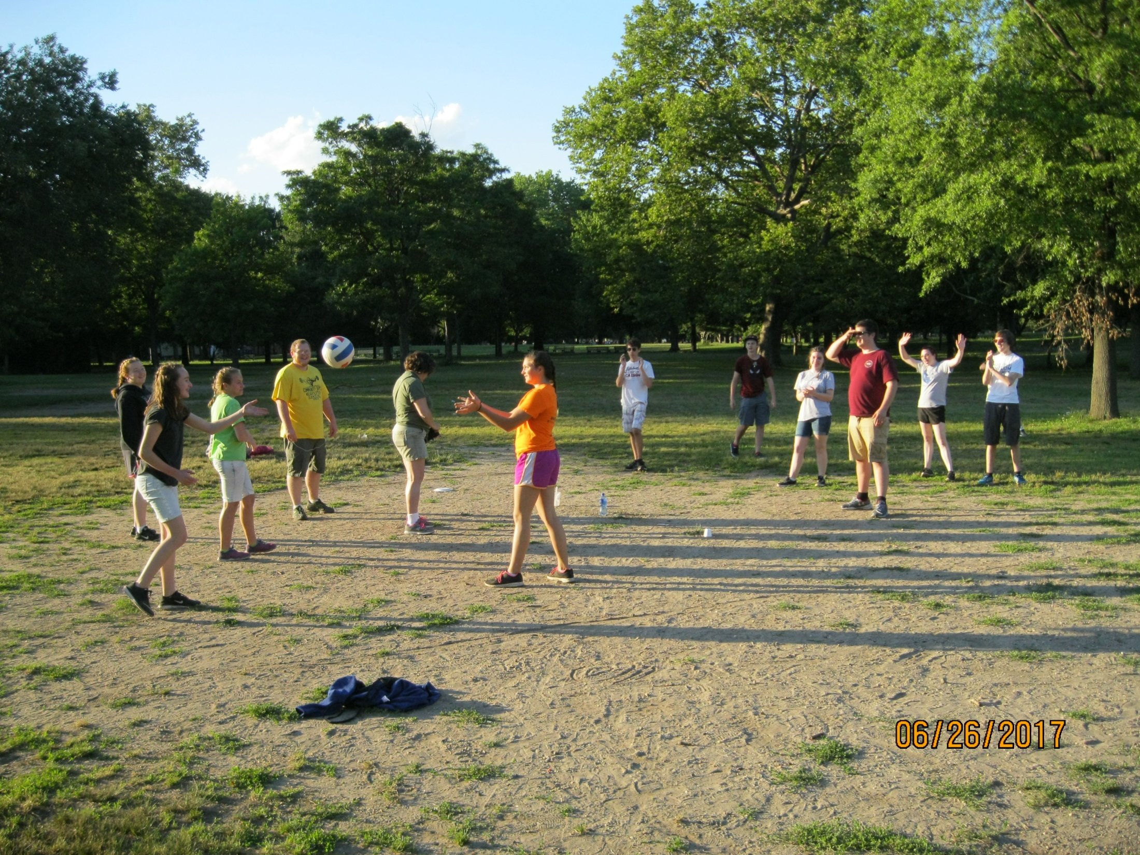

Slide 9
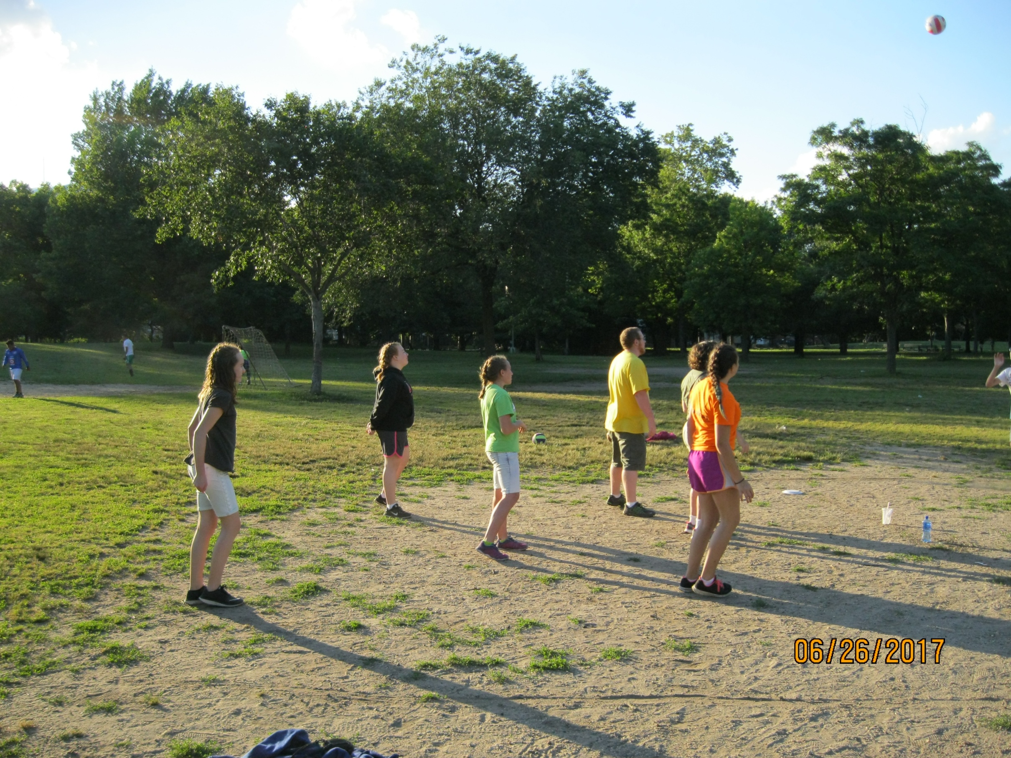

Slide 10
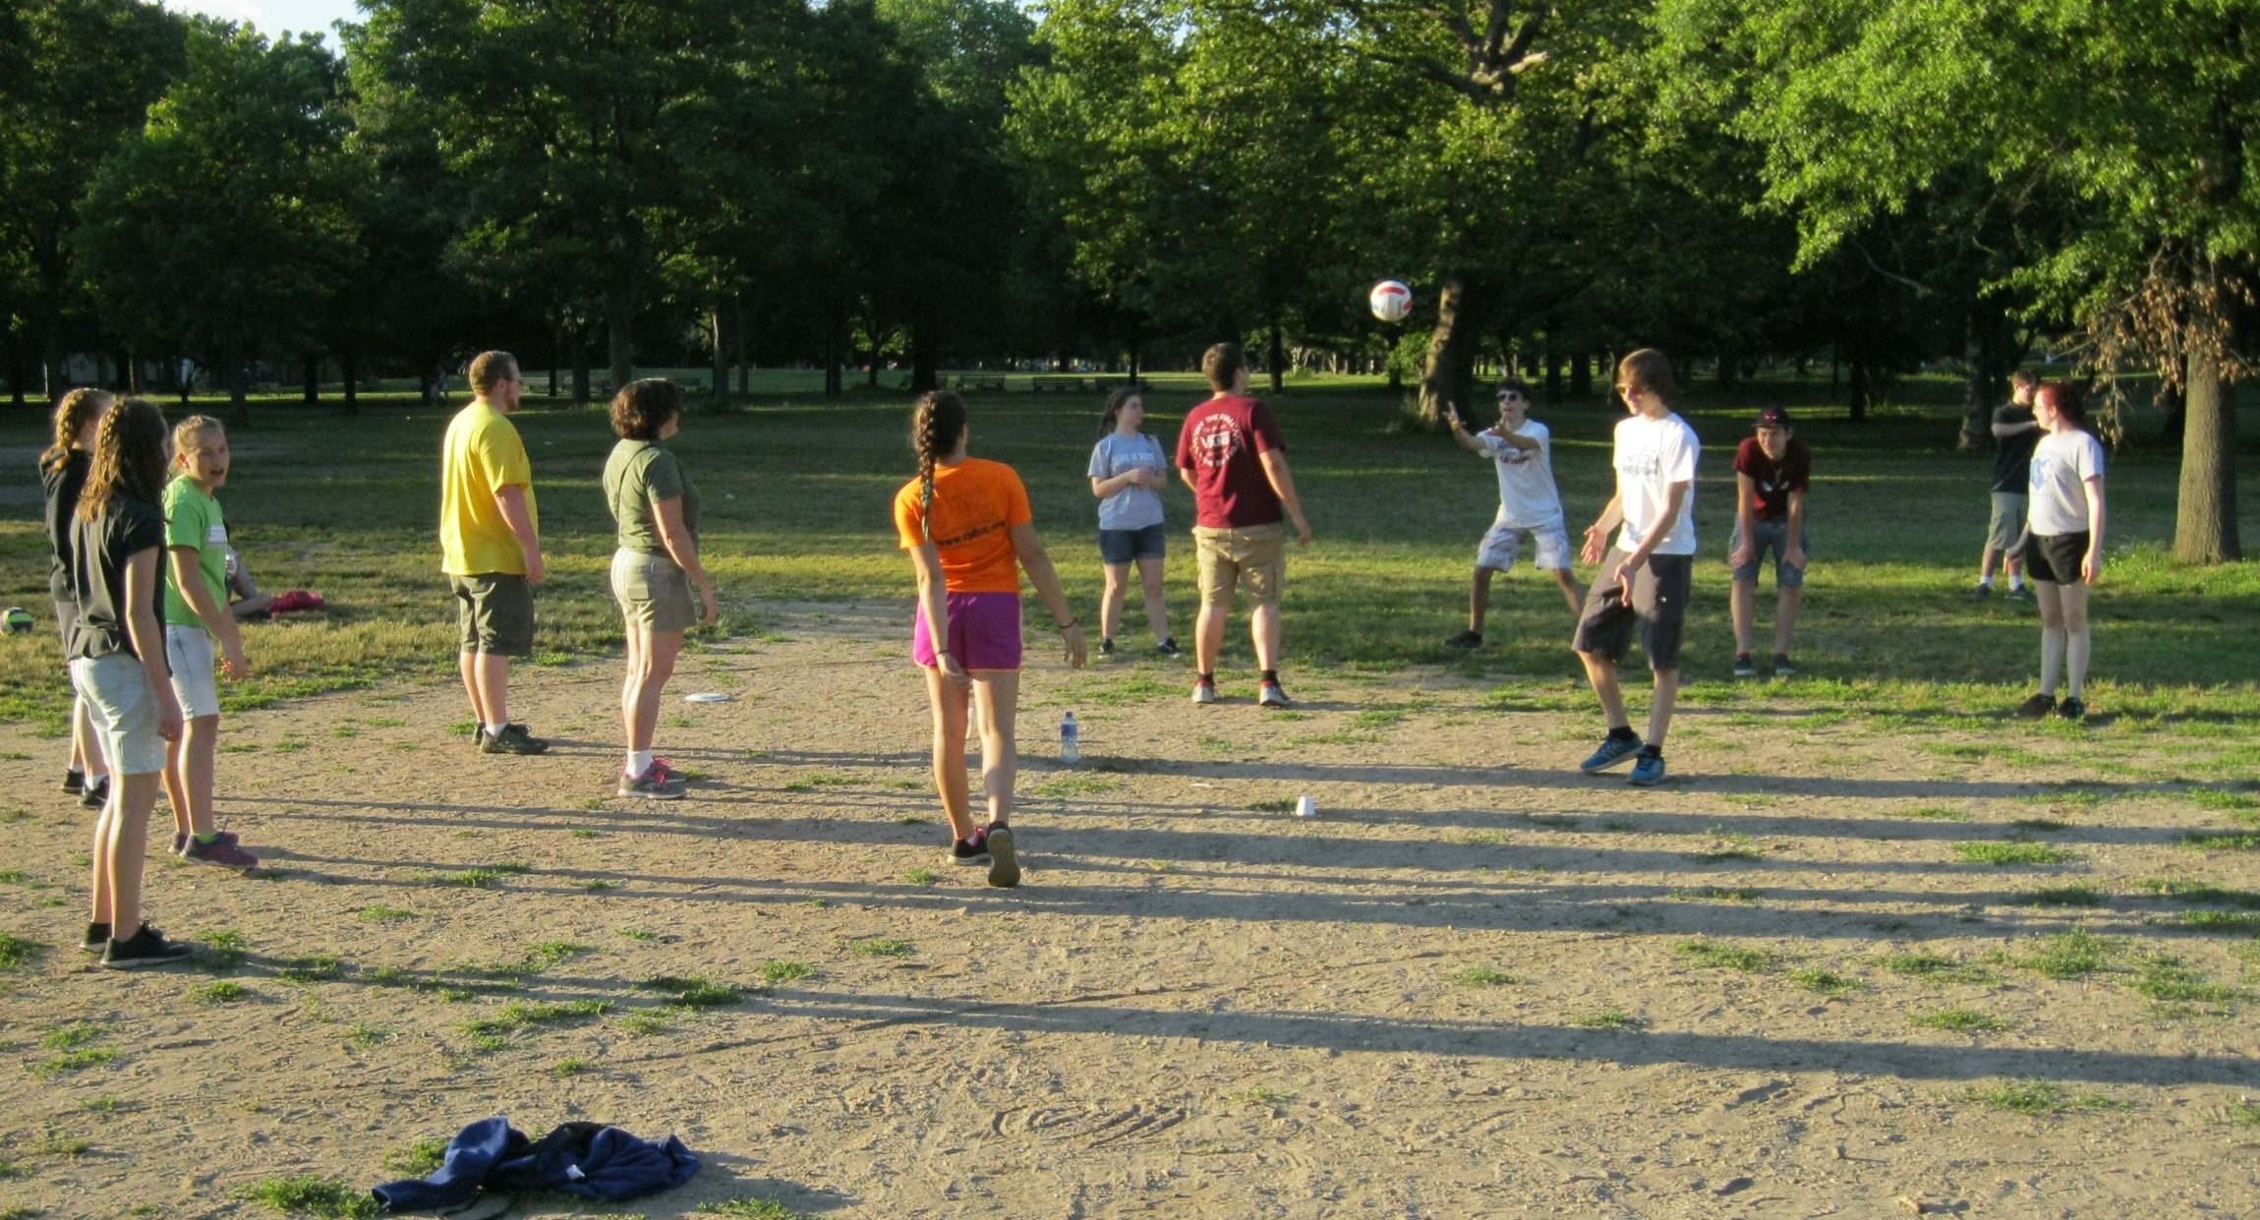

Slide 11
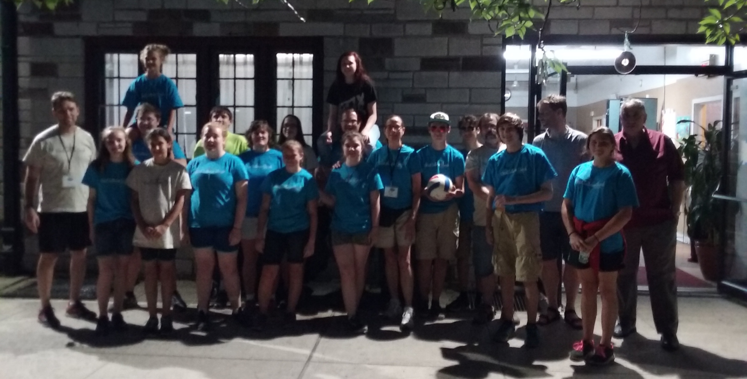
DELIVERED FOOD TO
THE LION’S SHARE FOOD PANTRY
AT ST. MARK’S EPISCOPAL CHURCH

Slide 12
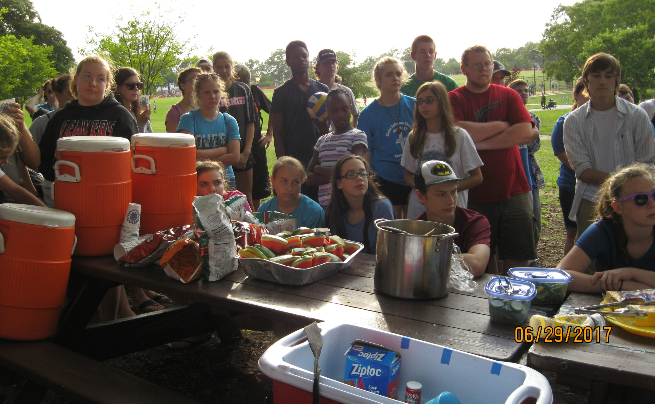
Went on a GROUP PICNIC at a local park and enjoyed line dancing, corn hole, some cheer moves and of course eating!

Slide 13
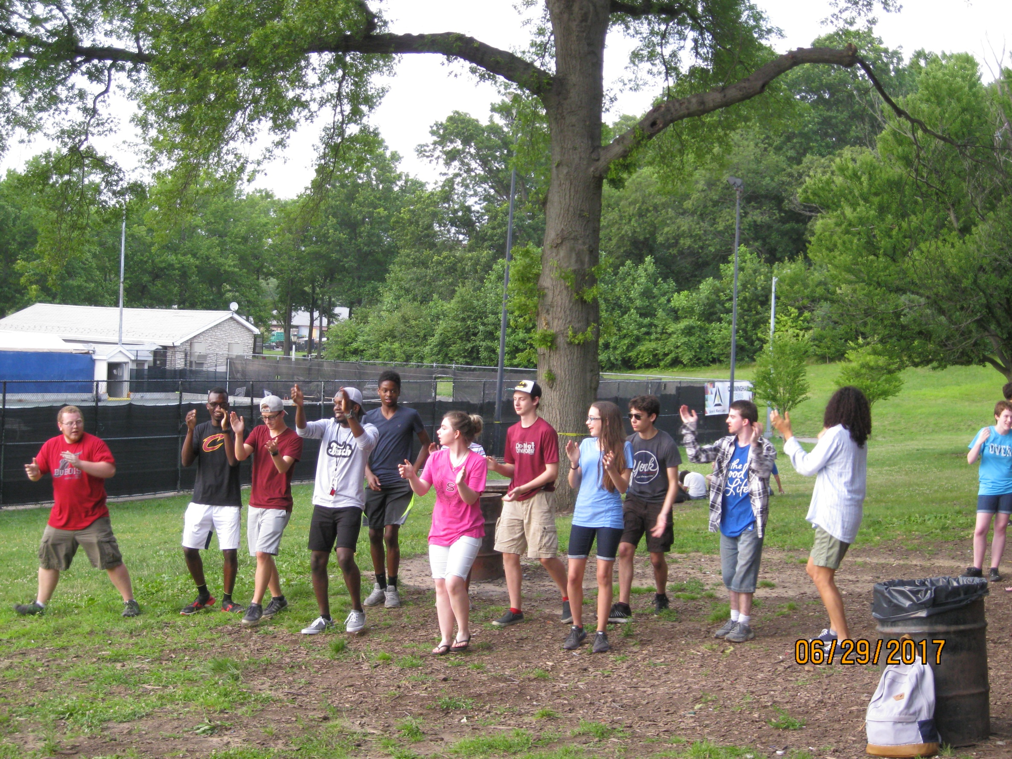

Slide 14
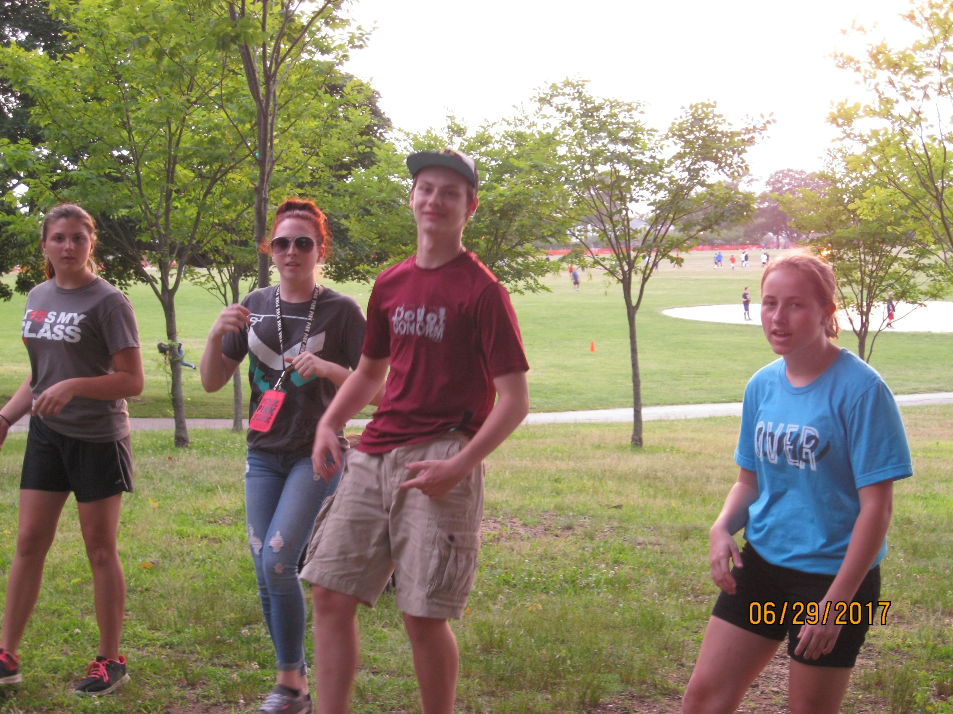

Slide 15
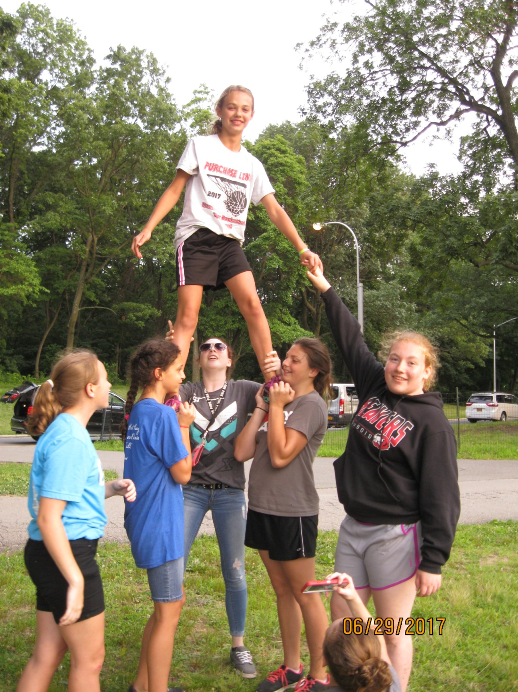
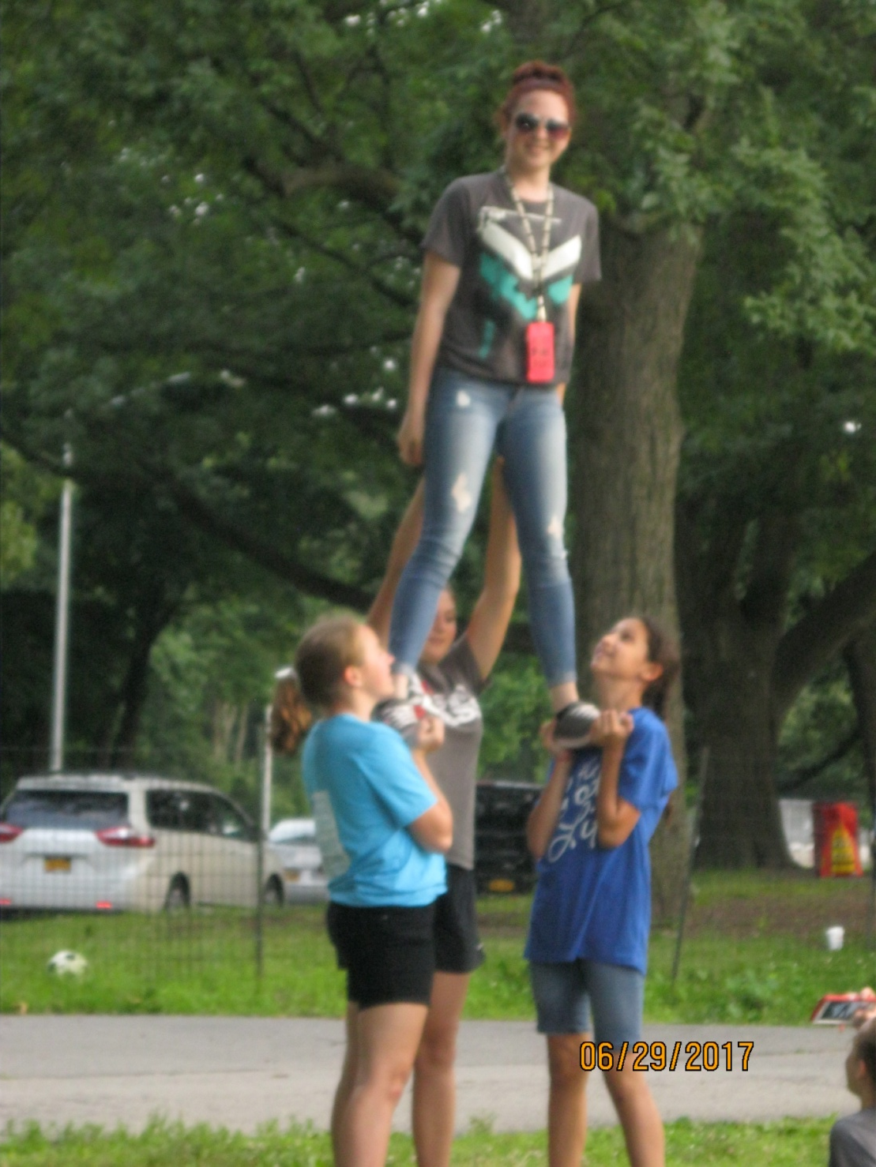

Slide 17
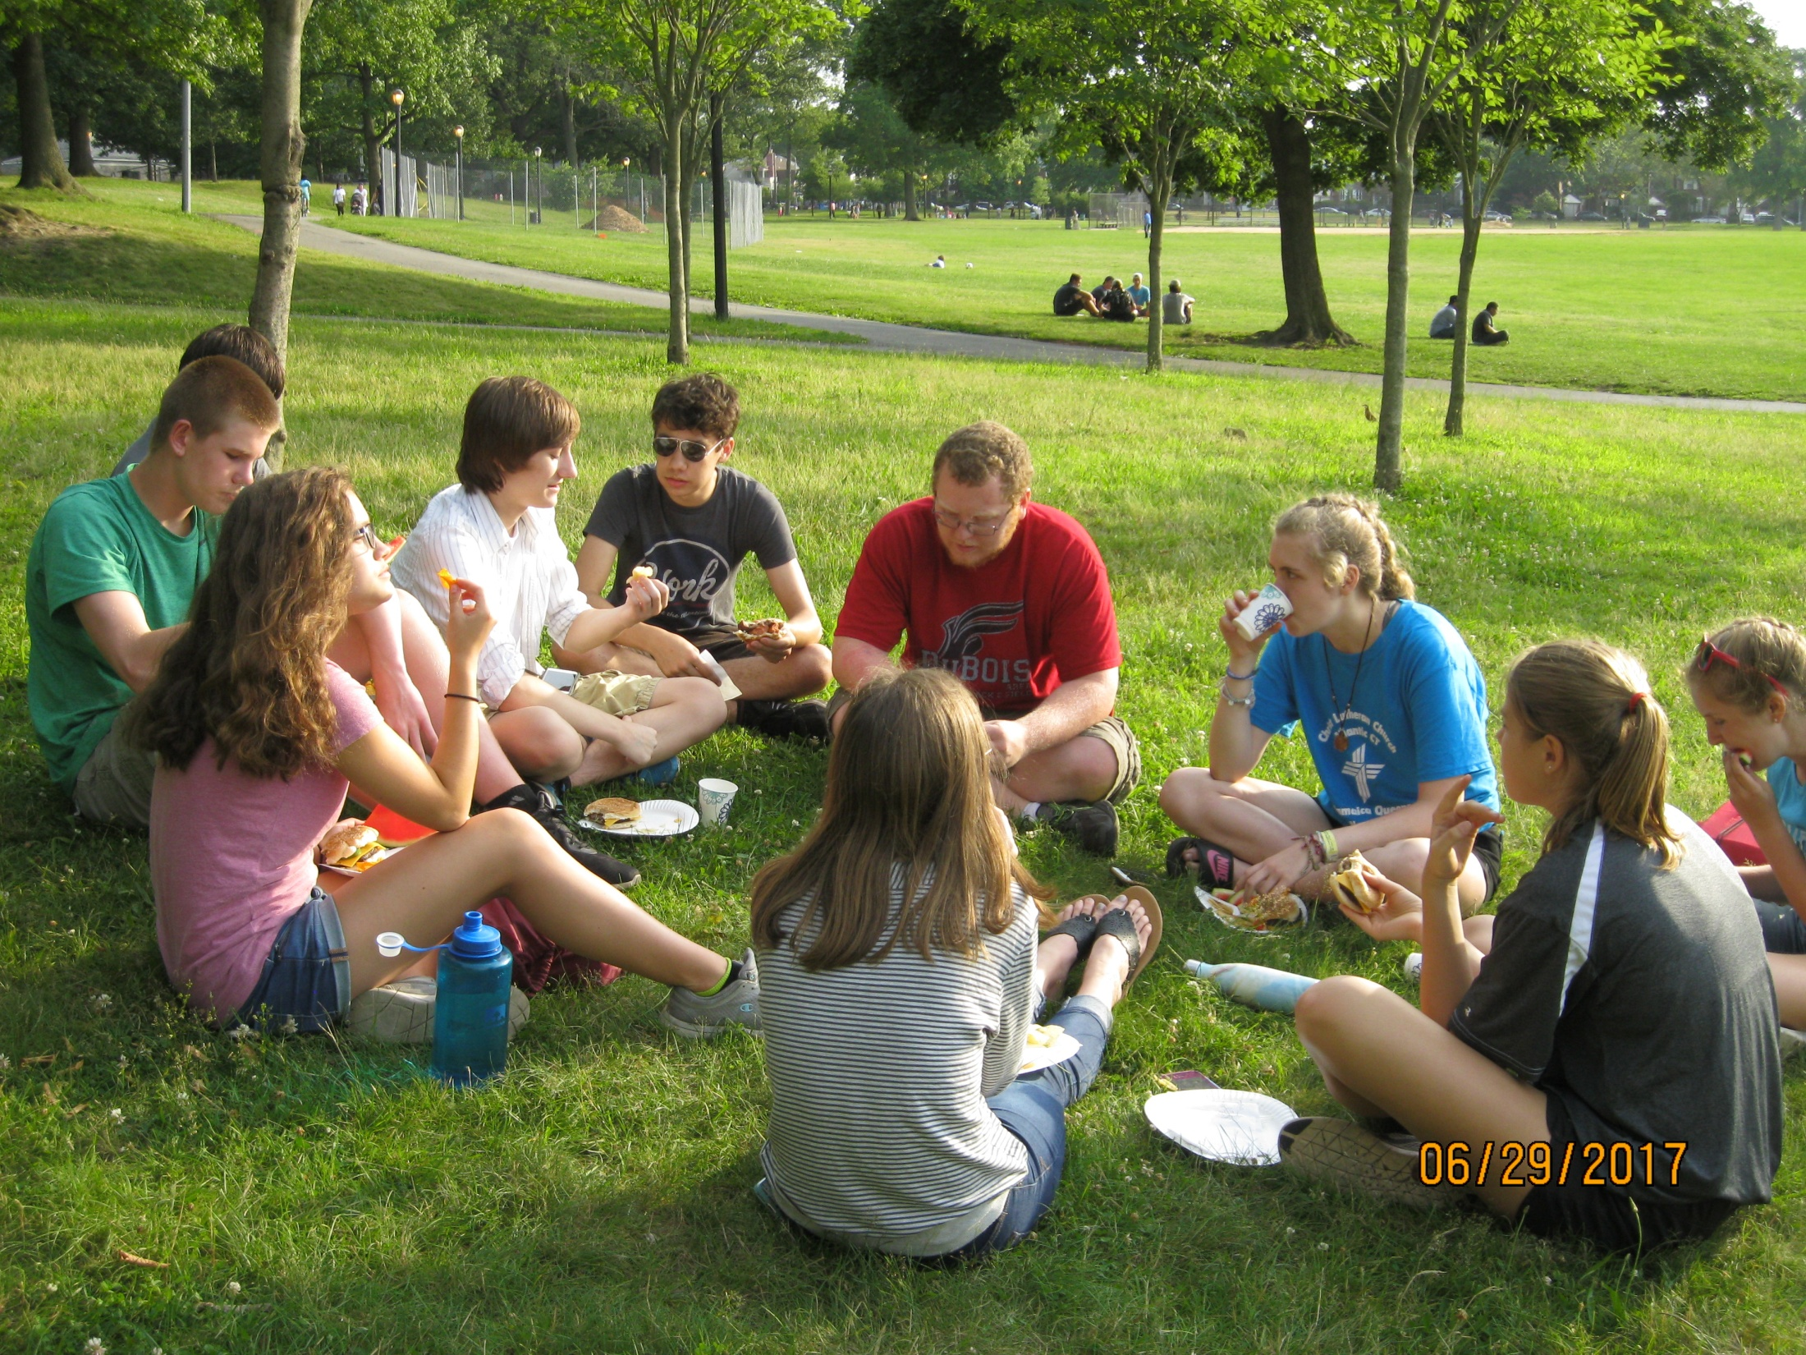

Slide 18
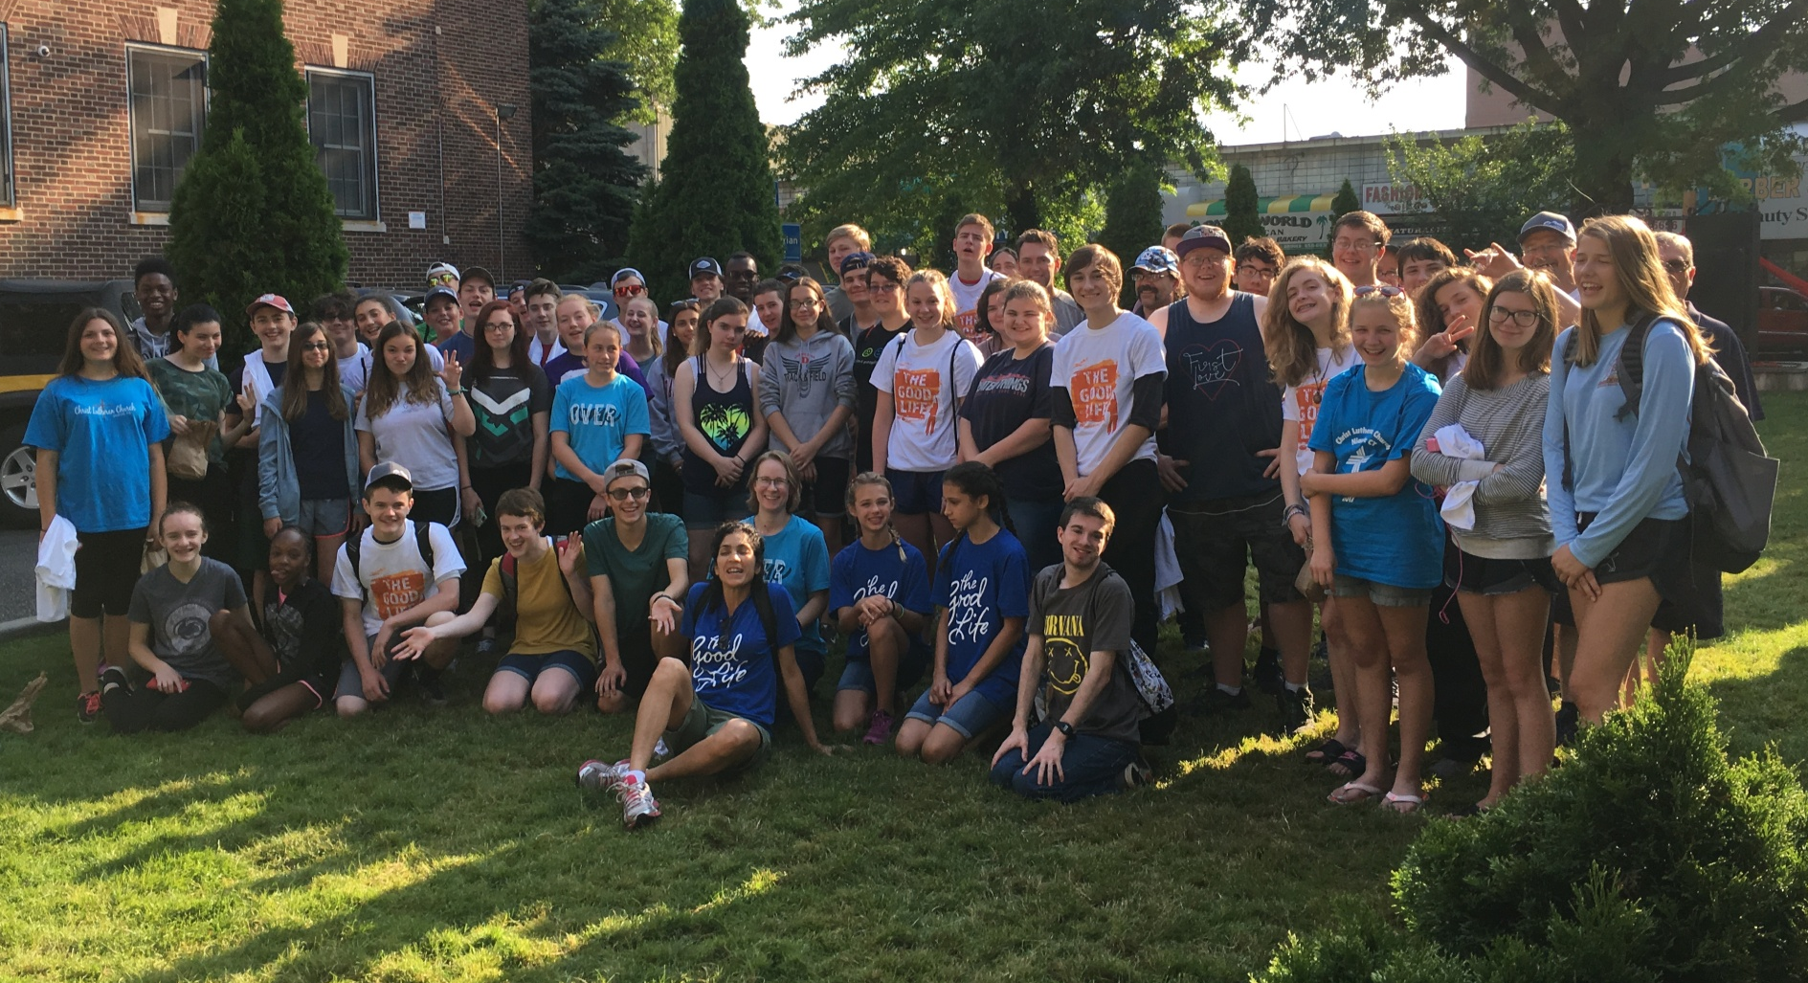
THE WHOLE GROUP!

Slide 19
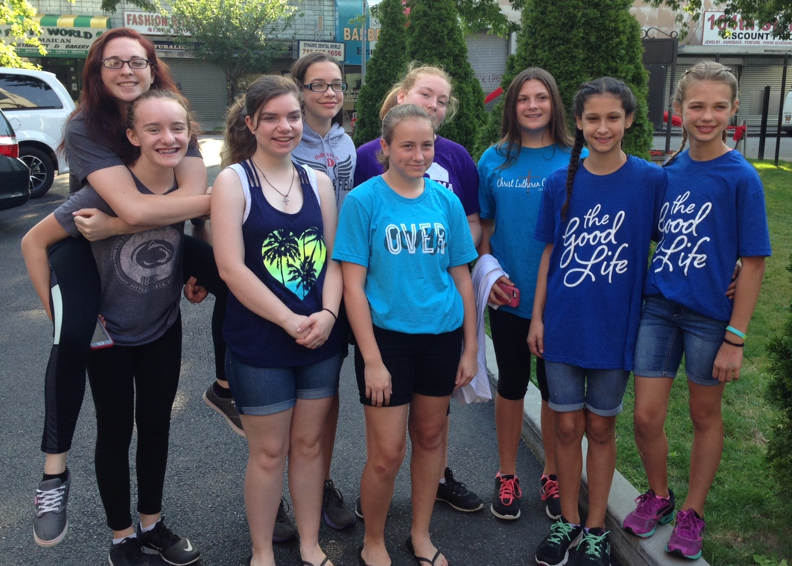
THANKS FOR ALL YOUR SUPPORT!!

